Slide 1
New User Interface
(New U.I.)
PBS
17-3 Release
2017-09-11

Slide 2
PBS – New U.I.
System Requirements
Overview of New User Interface
Bid Tab
New Features / Changes
Support
NOTE:
  The information in this presentation is correct as of 2017-08-30
  Further testing and evaluation is still to be completed

Slide 3
New U.I.
System Requirements

Slide 4
New U.I. – System Requirements
Supported Devices/Systems
PC + Windows 7+
Microsoft Surface Pro
Microsoft Surface Pro 3
Microsoft Surface RC
iPad Air
iPad Mini
iPhone 6/6S Plus (Landscape Mode)

Slide 5


New U.I. – System Requirements
Supported Browsers: PC
IE 10+
Chrome

Slide 6
New U.I. – System Requirements
Supported Browsers: MS Surface
Windows RT 8.1
Windows 10 Pro
Supported Browsers: iPad
Mobile Safari 9
Mobile Safari 8
Chrome

Slide 7
New U.I. – System Requirements
  Supported Devices and Browsers:
  Supported = These devices and browsers have been tested and work with the version of PBS
  Support for additional systems and browsers continue to be included
    Eg: Mac OS – Winter 2017 / Spring 2018

Slide 8
New U.I. – System Requirements
  Will other browsers/devices work?
  Yes but…
    There may be visual differences
    Possible loss of functionality
    Some aspects may not work properly
    Fixes may not be done

Slide 9
New U.I. – System Requirements
  Why the change?
  Loss of support for older systems/browsers
  New/updated browsers bring additional functionality to PBS
  PBS software/data is now downloaded in the browser eliminating the back-forth between the device and the PBS servers
  Allows for “off-line” bid creation/pairing searches

Slide 10
New U.I. – System Requirements
  If something goes wrong…
  Most issues are from old data in your browser
  Whenever there is an update:
    Clear Cache and Web Data (if applicable)

Slide 11
New U.I.
Overview

Slide 12
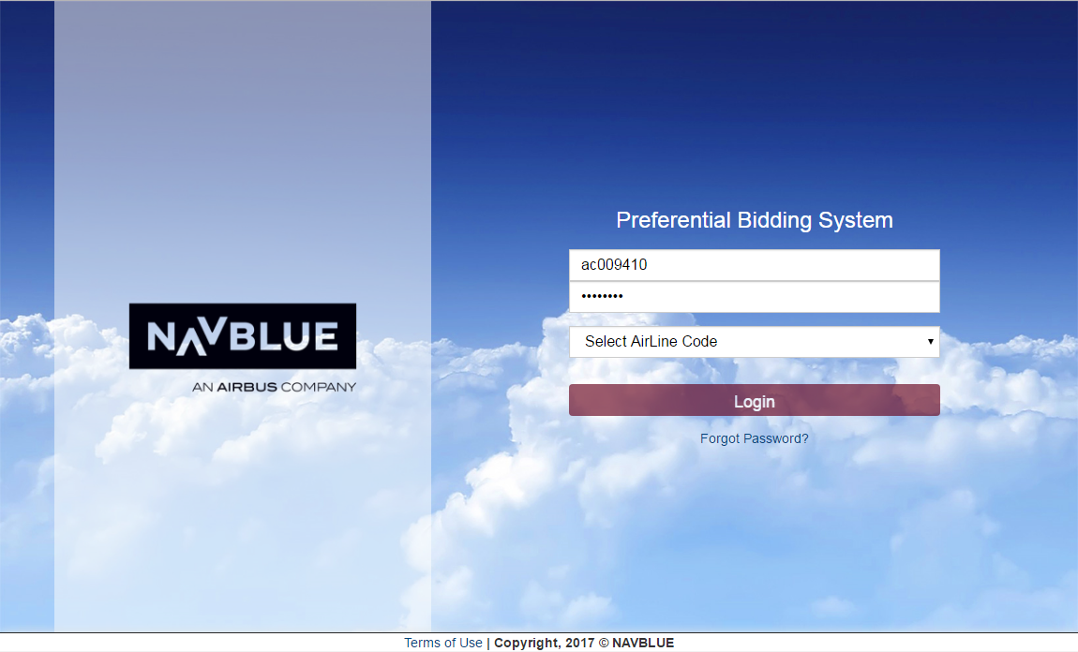
New U.I. - Overview

Slide 13
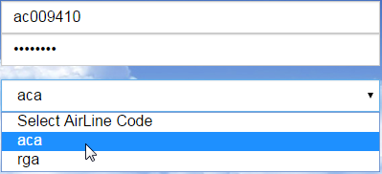
New U.I. - Overview

Slide 14
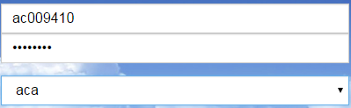
New U.I. - Overview

Slide 15
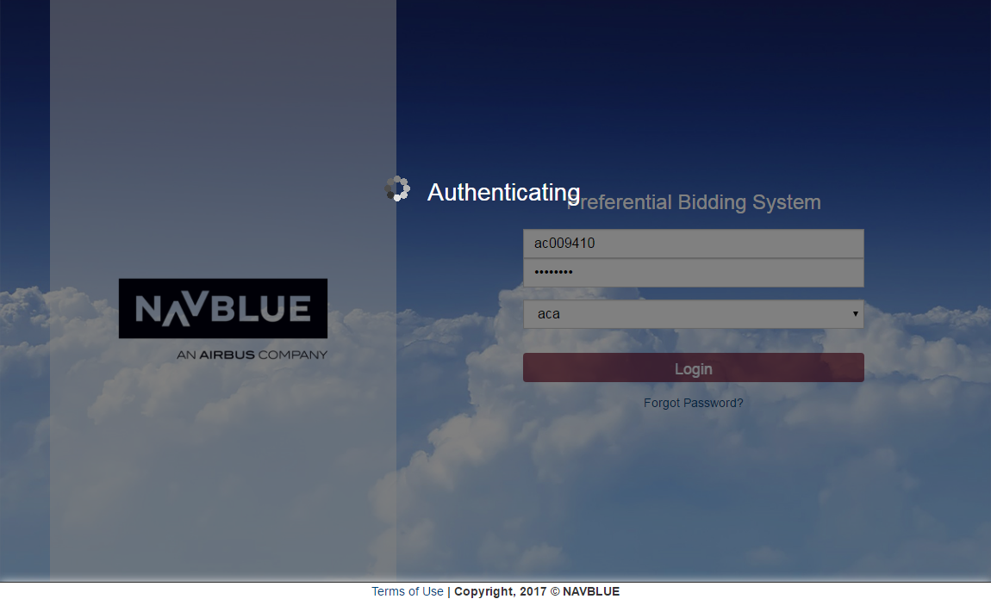
New U.I. - Overview

Slide 16

New U.I. - Overview

Slide 17
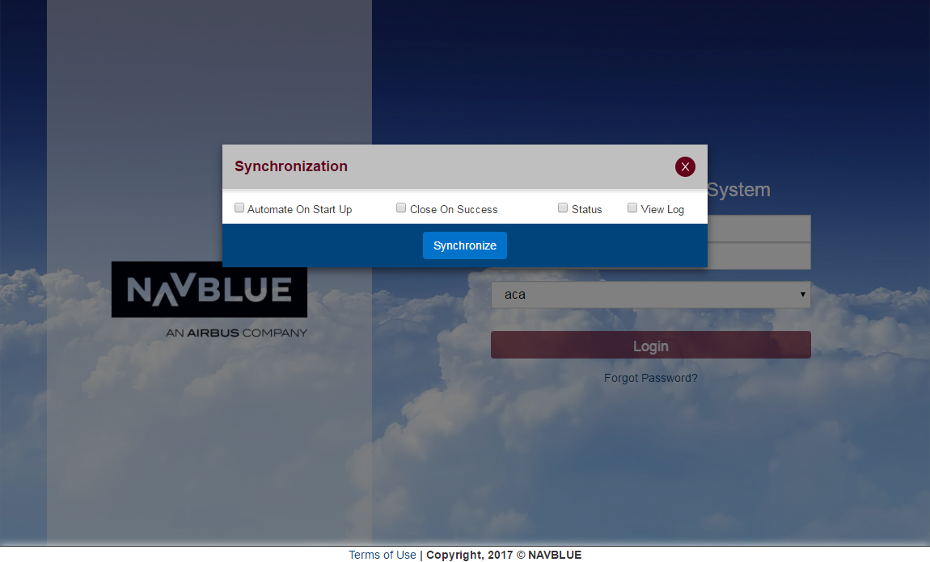
New U.I. - Overview

Slide 18
New U.I. - Overview

Slide 19
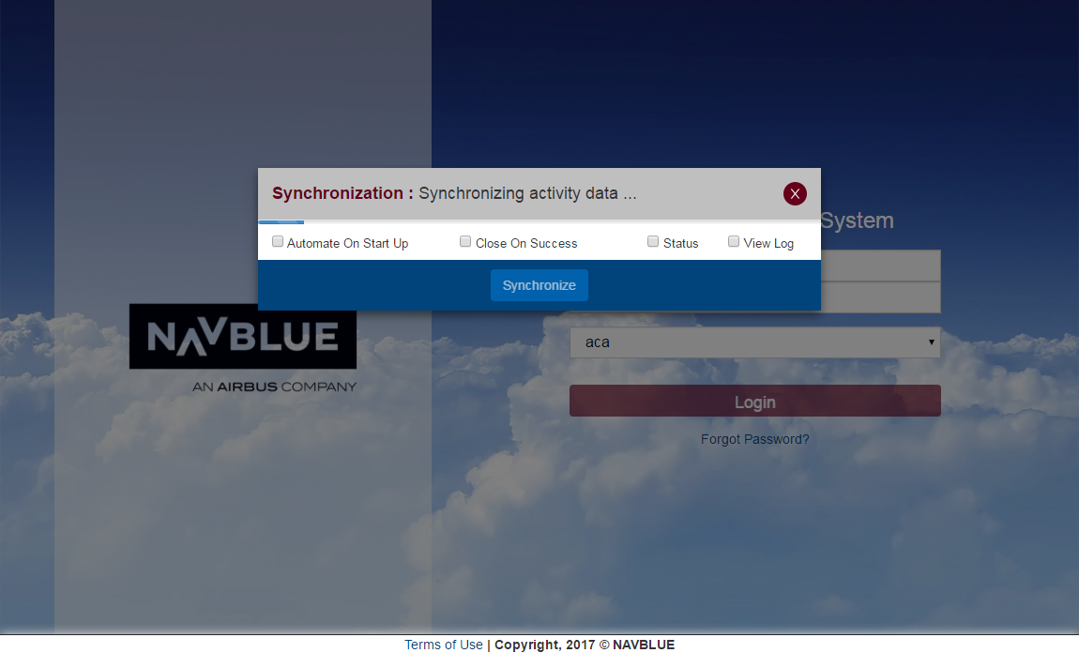
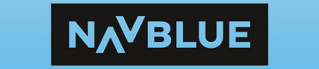


New U.I. - Overview
Synchronize information on bids/pairings/etc.

Slide 20
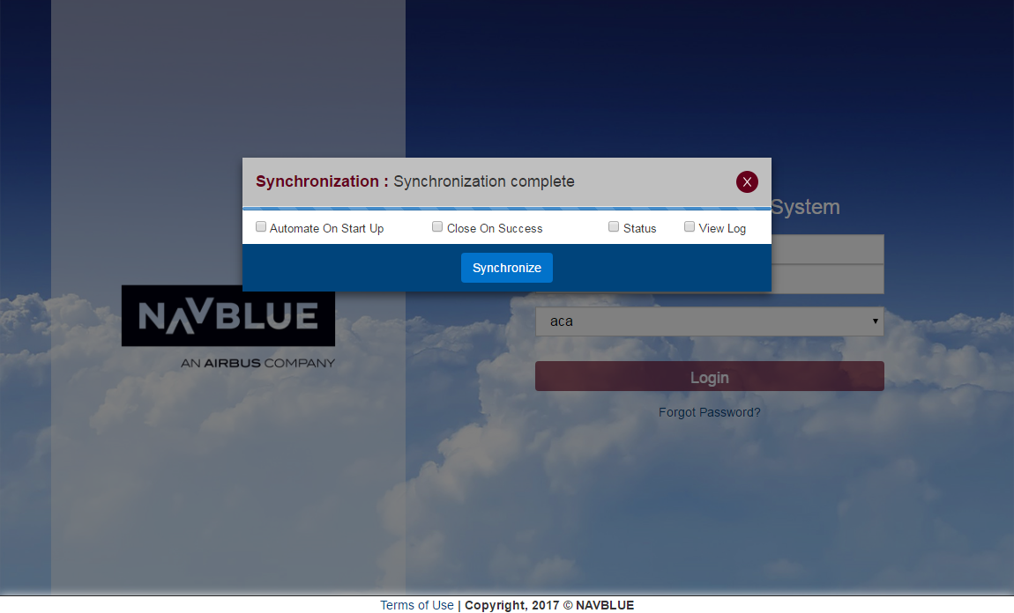
New U.I. - Overview

Slide 21
New U.I. - Overview
Close pop up when Synchronization is complete

Slide 22

New U.I. - Overview
Synchronization process may be automated for future log ins

Slide 23
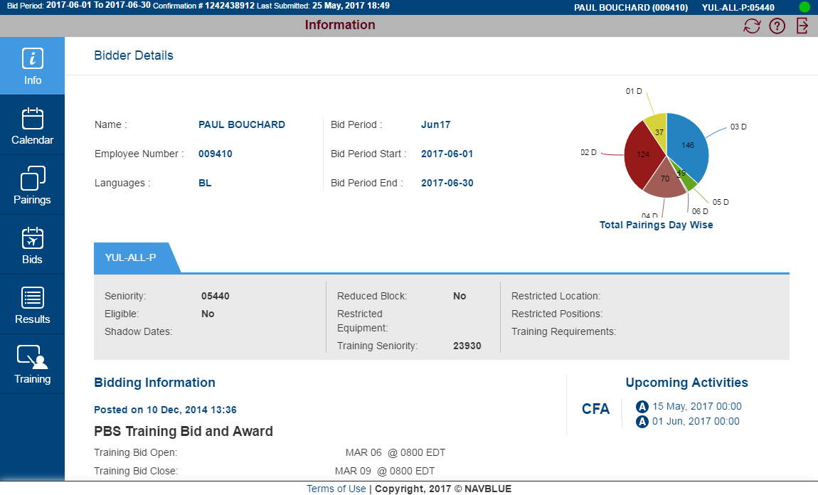
New U.I. - Overview
TABS
Navigate with tabs

Slide 24
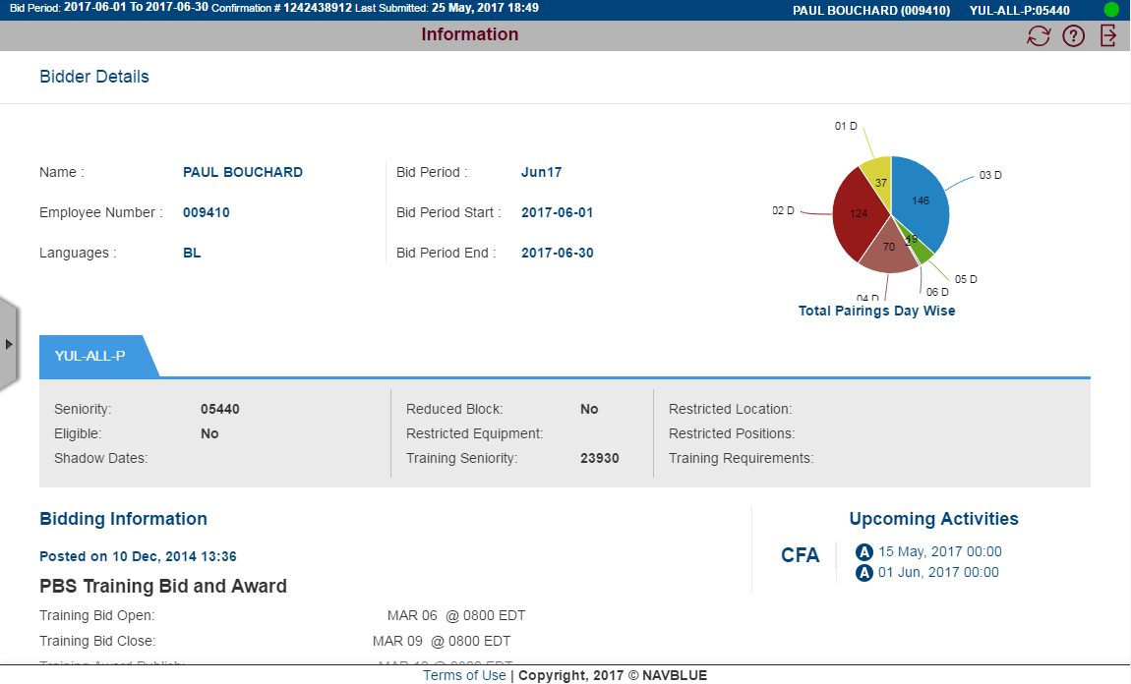
New U.I. - Overview
LOW Res / iPad
On low resolution screens or iPads, the panel may be hidden

Slide 25
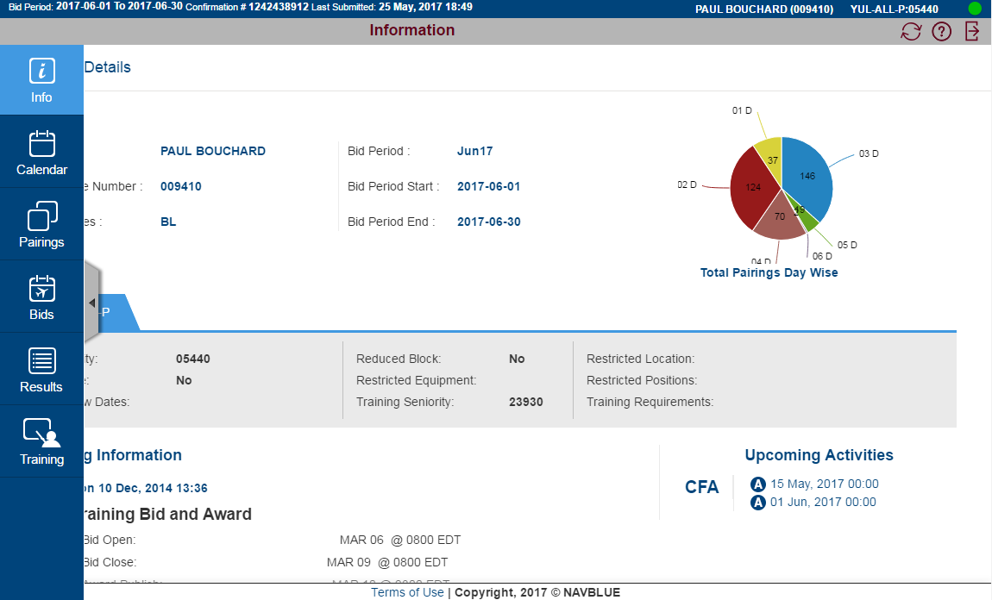
New U.I. - Overview
LOW Res / iPad
Clicking on the arrow to the left of the page will bring it back

Slide 26
New U.I. - Overview
Info

Slide 27
New U.I. - Overview
Information about you, the bid period, block month, bid window

Slide 28
New U.I. - Overview
Bid Period, Confirmation # + Date, Time

Slide 29
New U.I. - Overview
Name, Base + Classification + Seniority Number

Slide 30
New U.I. - Overview
On-line / Off-line indicator

Slide 31
New U.I. - Overview
On-line / Off-line indicator
On-line
Off-line

Slide 32
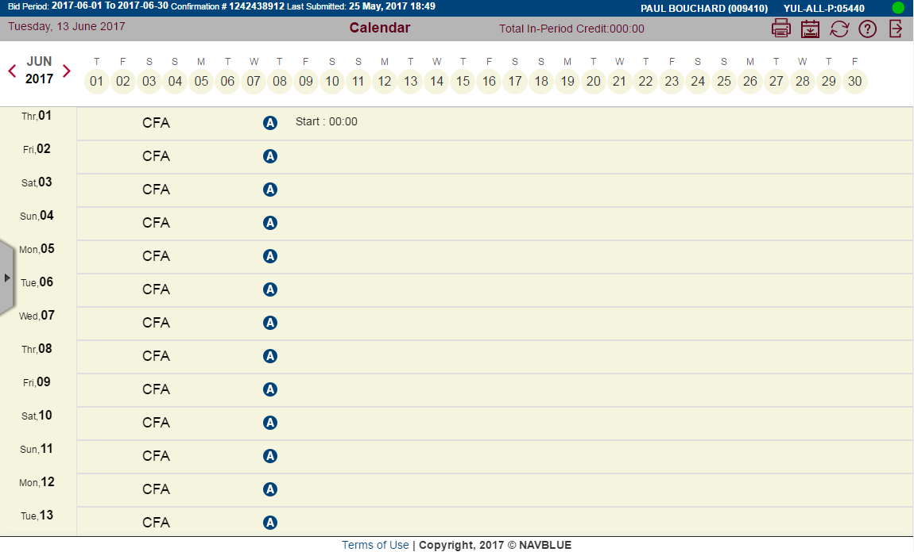
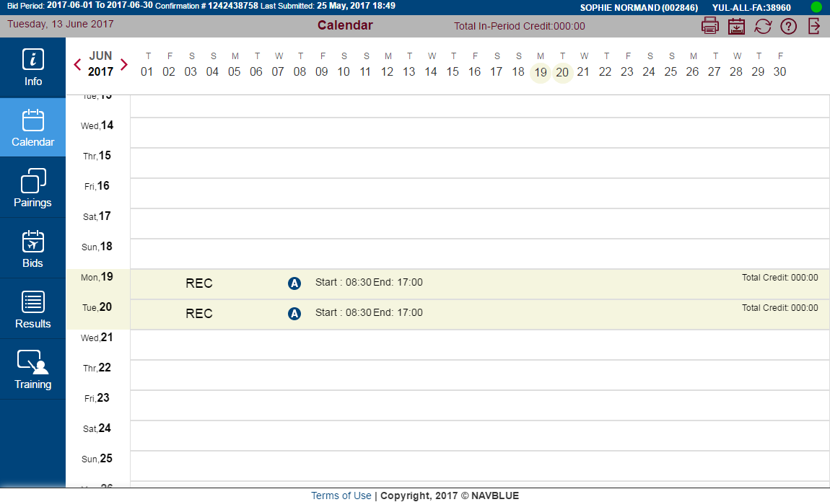
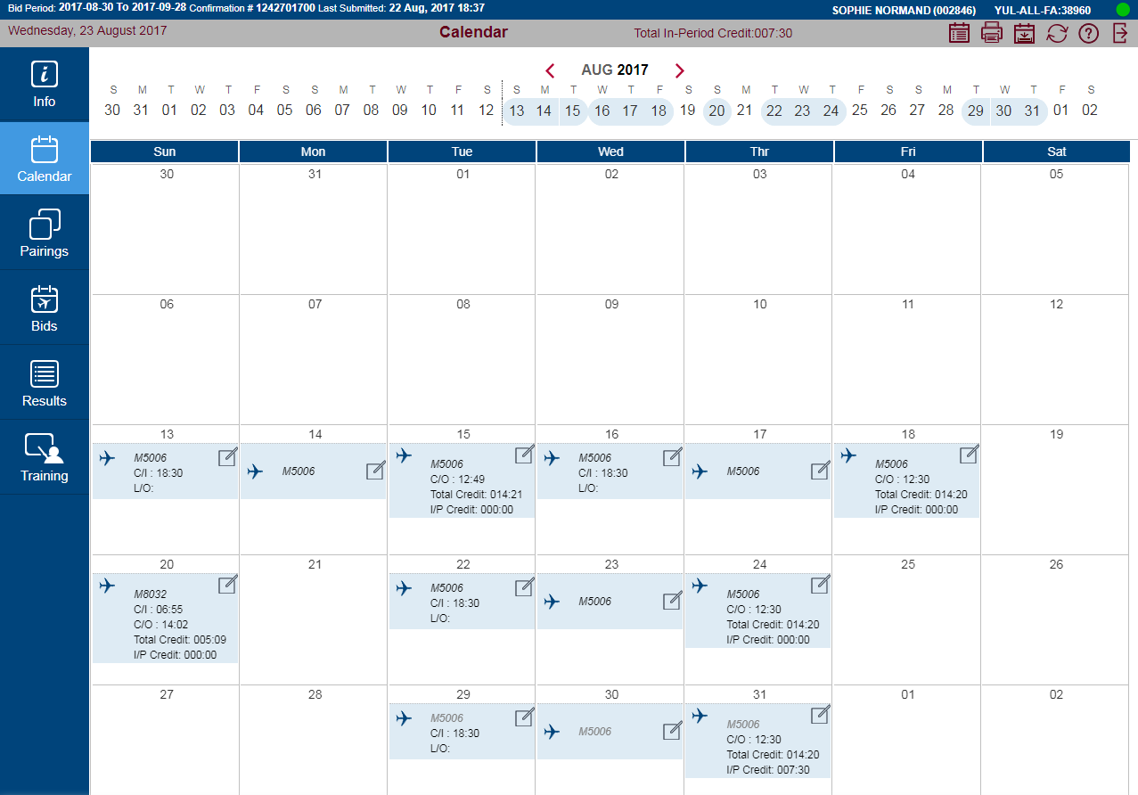
New U.I. - Overview
Calendar

Slide 33
New U.I. - Overview
Calendar: Activities for the next bid period are displayed

Slide 34
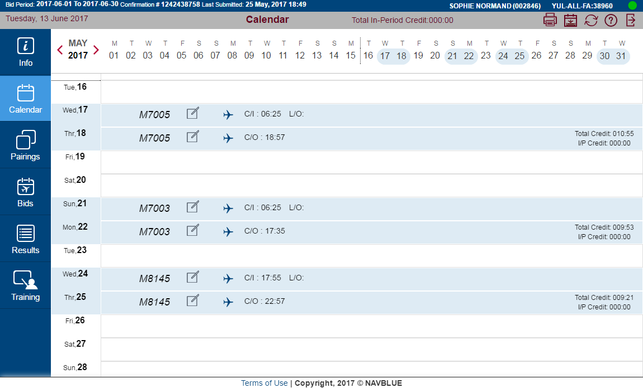
New U.I. - Overview
Pairings in blue

Slide 35
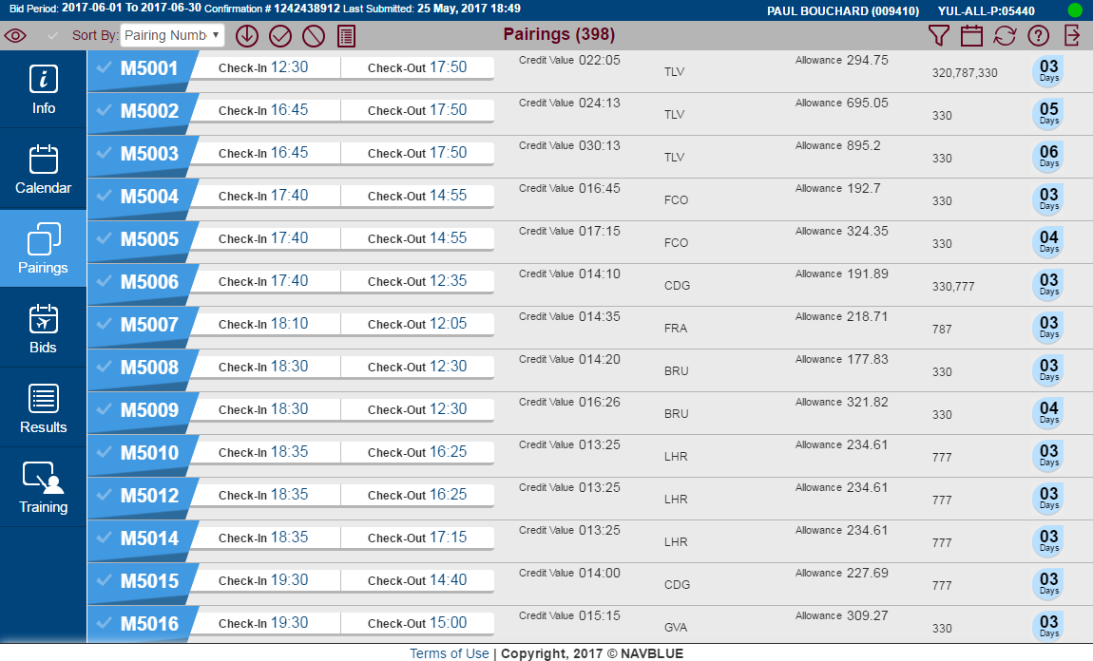
New U.I. - Overview
Pairings

Slide 36
New U.I. - Overview
All pairings at your base in your classification

Slide 37
New U.I. - Overview
Scroll up for more pairings

Slide 38
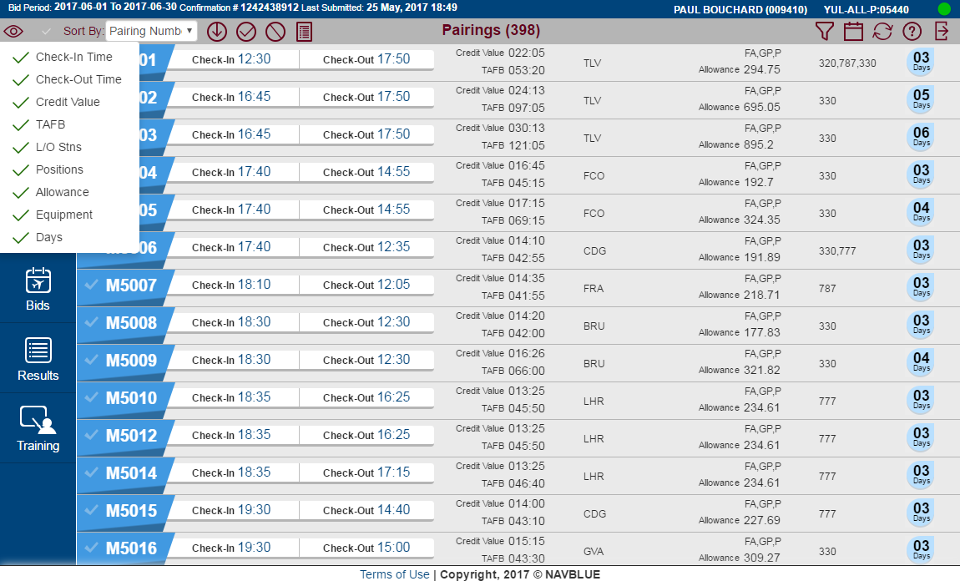
New U.I. - Overview
Change WHAT pairing information is displayed

Slide 39
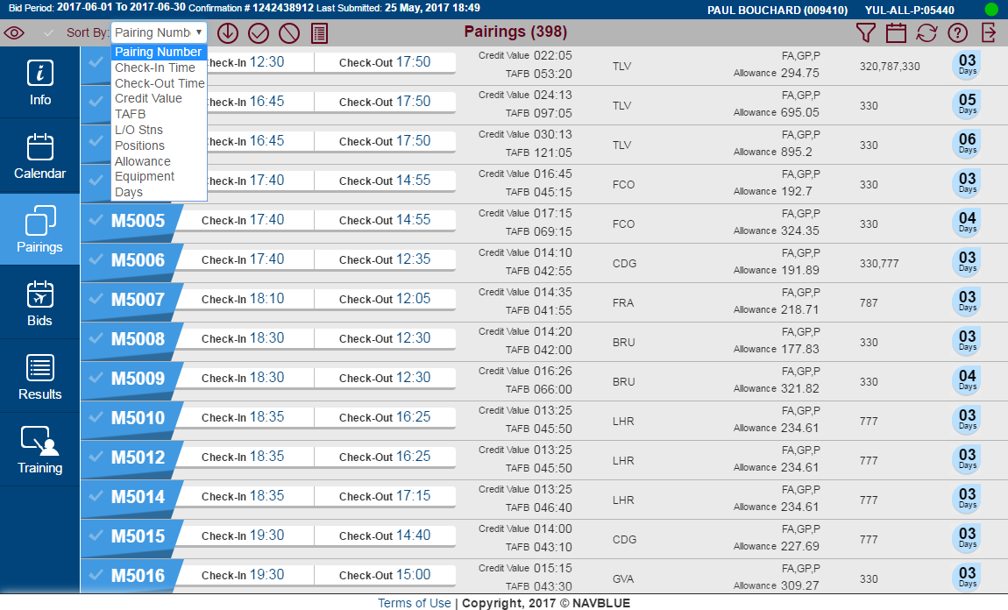
New U.I. - Overview
Change SORT order of the pairings

Slide 40
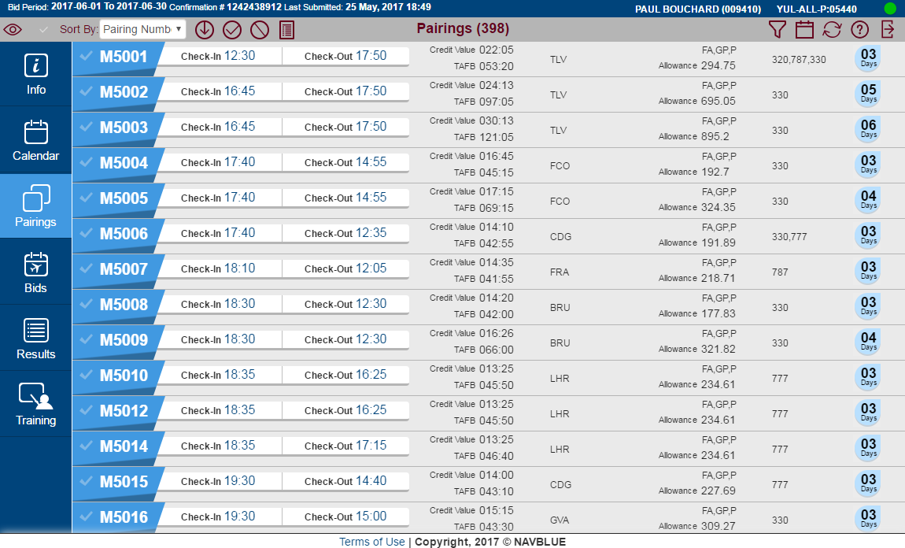
New U.I. - Overview
Change ORDER that pairings are displayed (Ascending–Descending)

Slide 41
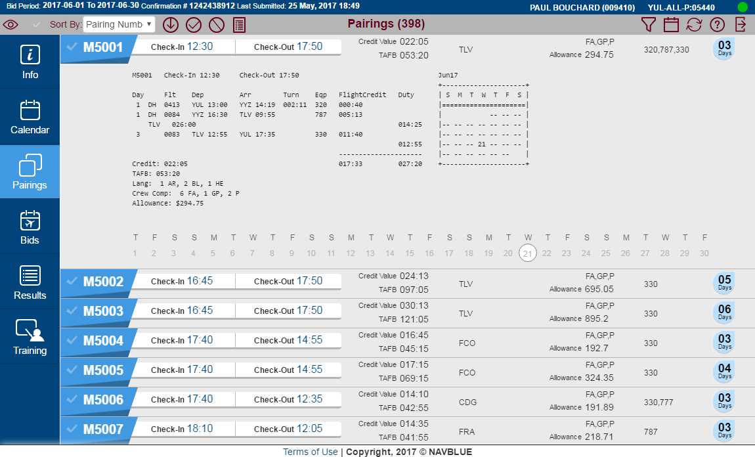
New U.I. - Overview
Click on PAIRING NUMBER to display additional pairing details

Slide 42

New U.I. - Overview
Select pairing(s) by clicking on the CHECK MARK

Slide 43
New U.I. - Overview
Selected pairing(s) may be:
- Added as an AWARD bid line to an active bid group

Slide 44
New U.I. - Overview
Selected pairing(s) may be:
- Added as an AVOID bid line to an active bid group

Slide 45
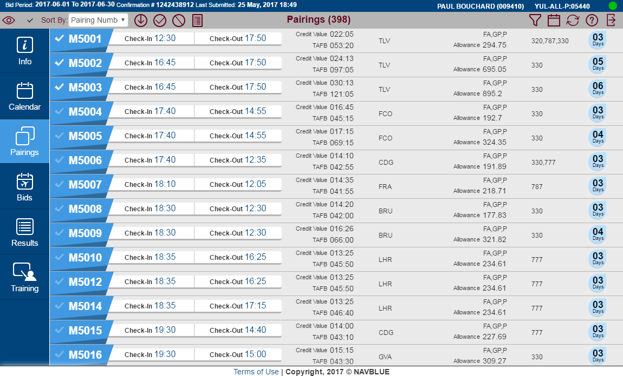
New U.I. - Overview
Selected pairing(s) may be:
- Used to create a Pairing Report

Slide 46
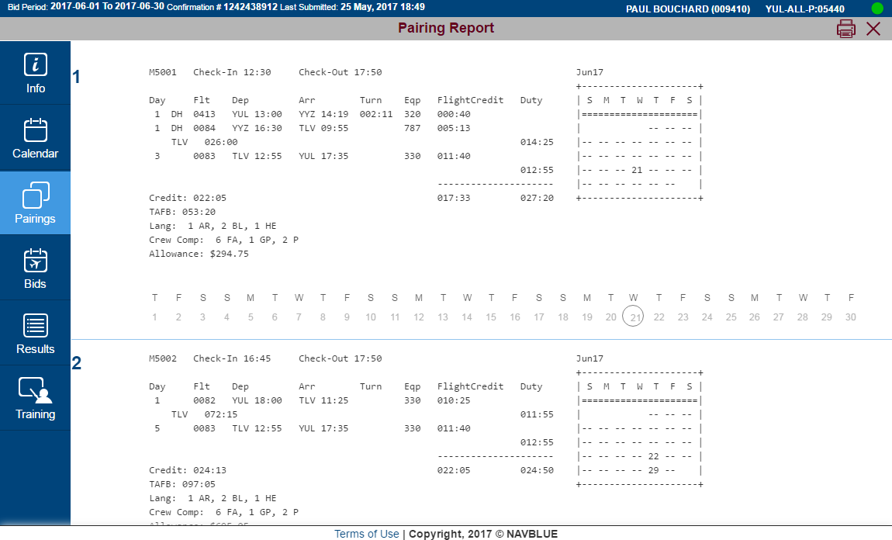
New U.I. - Overview
Print or close the report

Slide 47
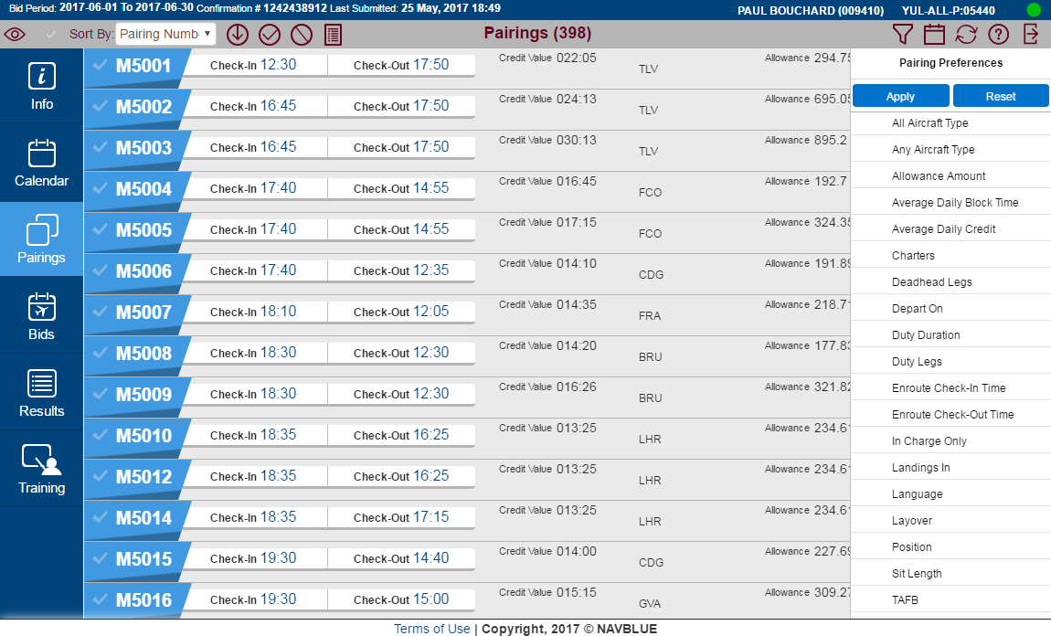
New U.I. - Overview
Search for pairings

Slide 48
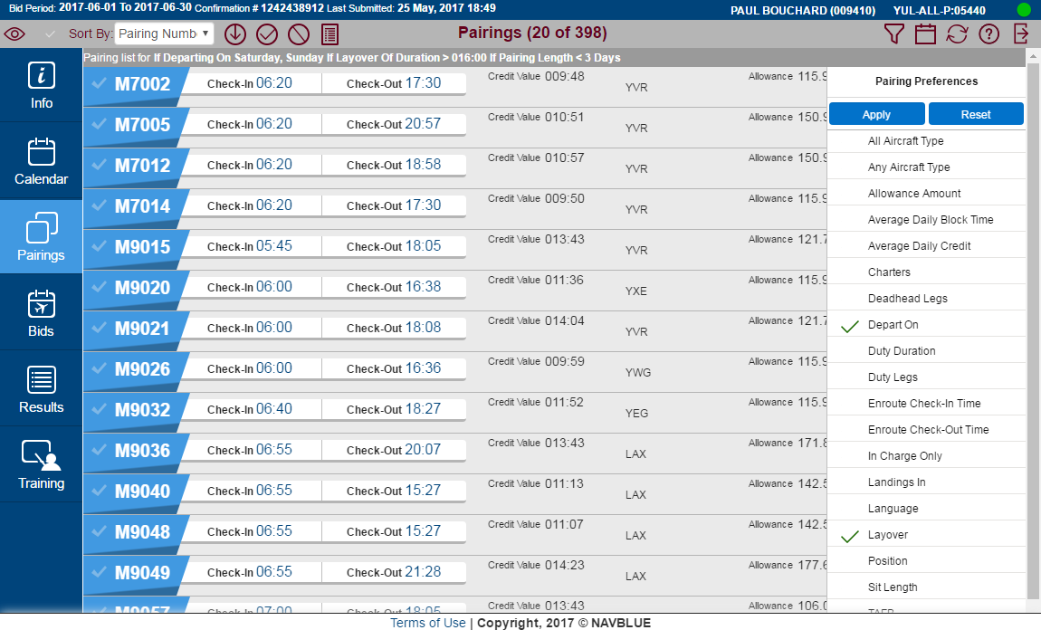
New U.I. - Overview
[B]
[A]
Search parameters [A]
Number of pairings matching search parameters [B]

Slide 49
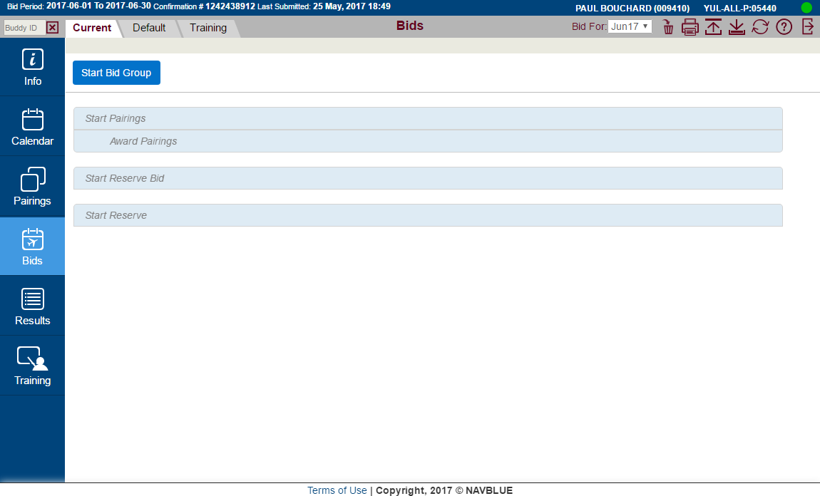
New U.I. - Overview
Bids

Slide 50
New U.I. - Overview
Same bid structure as now

Slide 51
New U.I. - Overview
Current Bid

Slide 52
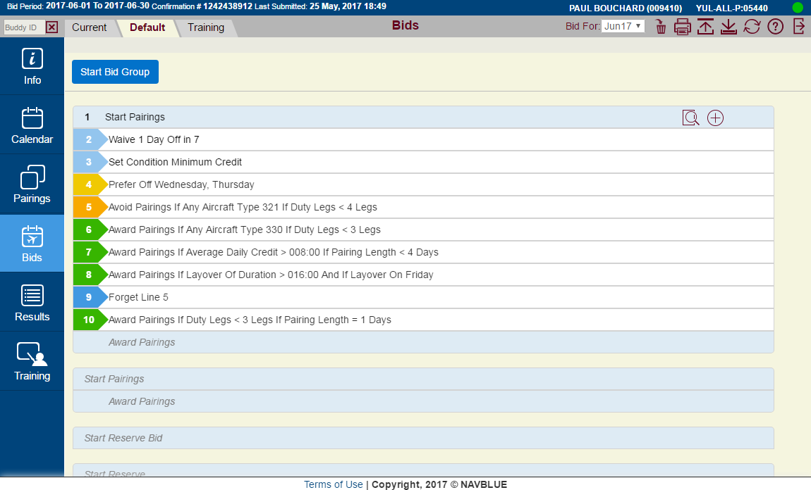
New U.I. - Overview
Default Bid

Slide 53
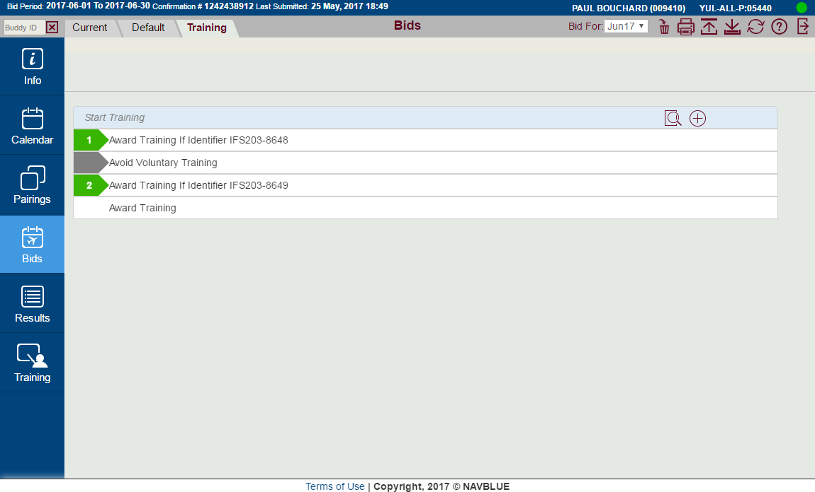
New U.I. - Overview
Training Bid

Slide 54
New U.I. - Overview
Colours help identify bid line types

Slide 55
New U.I. - Overview
1
Start Bid
2
Set Condition/Waive
4
Prefer Off
5
Avoid
6
Award
9
Instruction
Embedded
Colours help identify bid line types

Slide 56
New U.I. - Overview
White: CURRENT
Yellow tint: DEFAULT
Green tint: TRAINING
Colours help identify bid types

Slide 57
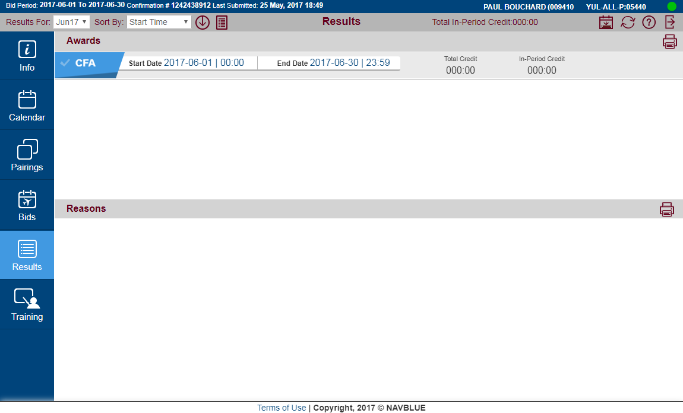
New U.I. - Overview
Results

Slide 58
New U.I. - Overview
Only pre-assigned absences are displayed
Use current Block Awards link on the portal

Slide 59
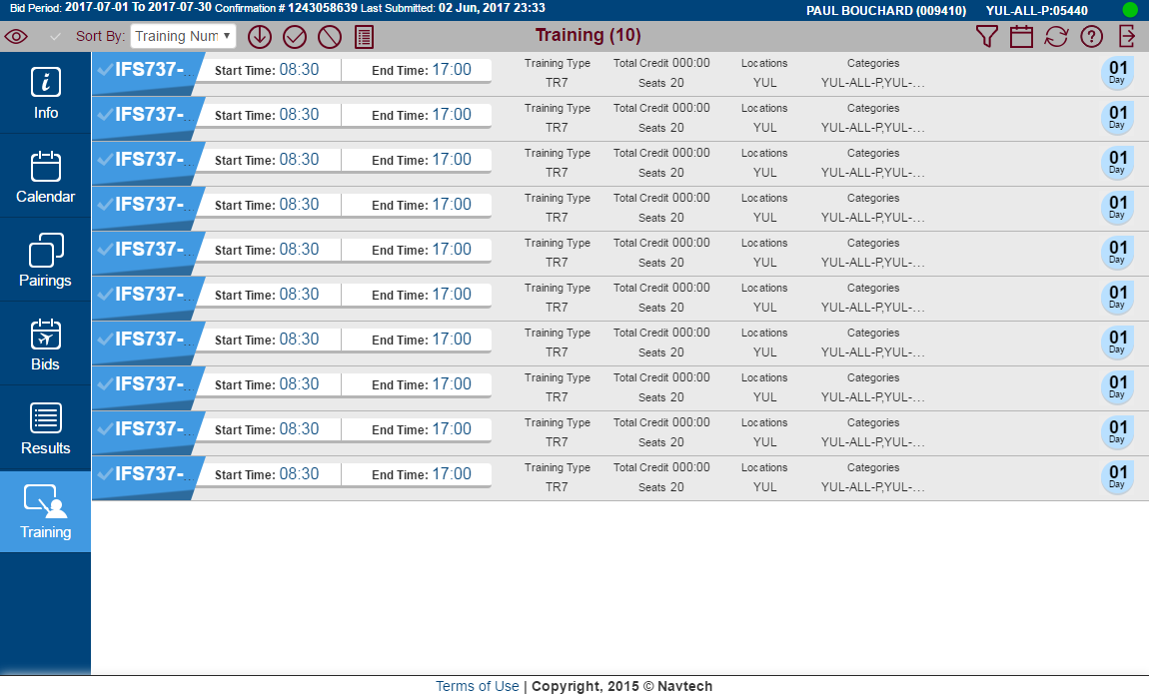
New U.I. - Overview
Training

Slide 60
New U.I. - Overview
Training Identifiers are displayed

Slide 61
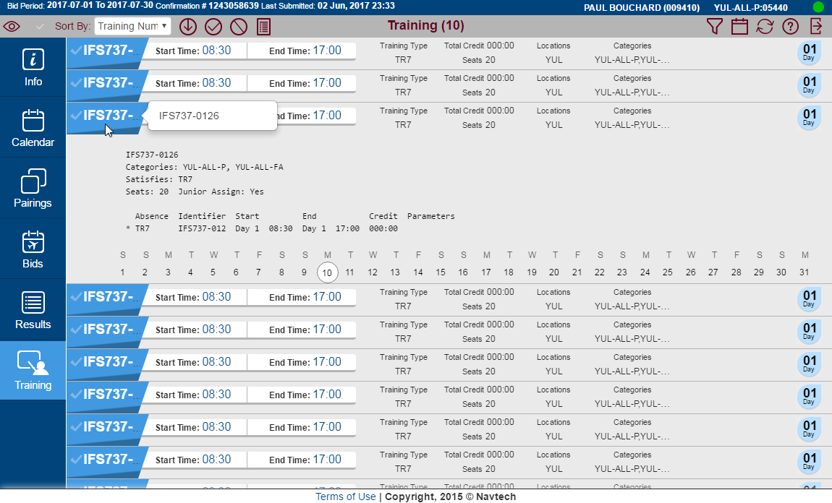
New U.I. - Overview
Training Identifier details shown when clicking on the identifier

Slide 62
New U.I.
Bidding

Slide 63

New U.I. - Bidding
The process of adding bid lines has changed

Slide 64
New U.I. - Bidding
The New U. I. uses a system similar to the PBS Desktop Bidder:
Bid lines are created in the same window
You see the progress of your bid line prior to applying it
Info from last bid line created remains in memory to facilitate cascading bid line creation

Slide 65
New U.I. - Bidding
Let’s do some simple bidding
We will create a Start Pairings bid group

Slide 66
New U.I. - Bidding
Select Start Bid Group

Slide 67
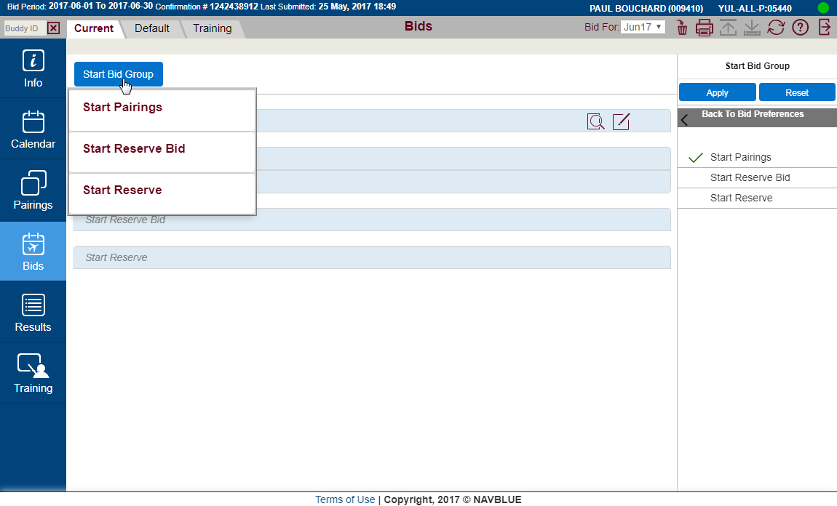
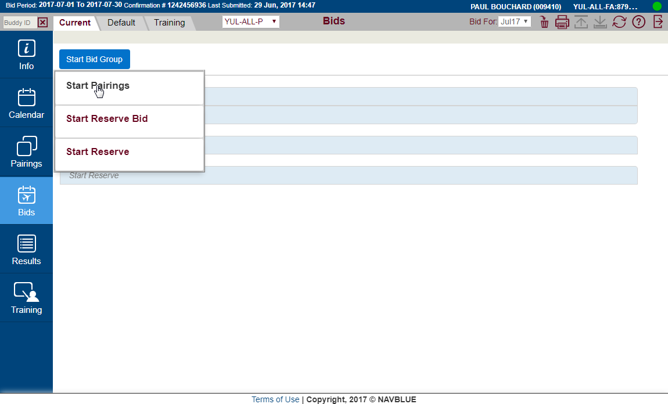
New U.I. - Bidding
Select Start Pairings

Slide 68
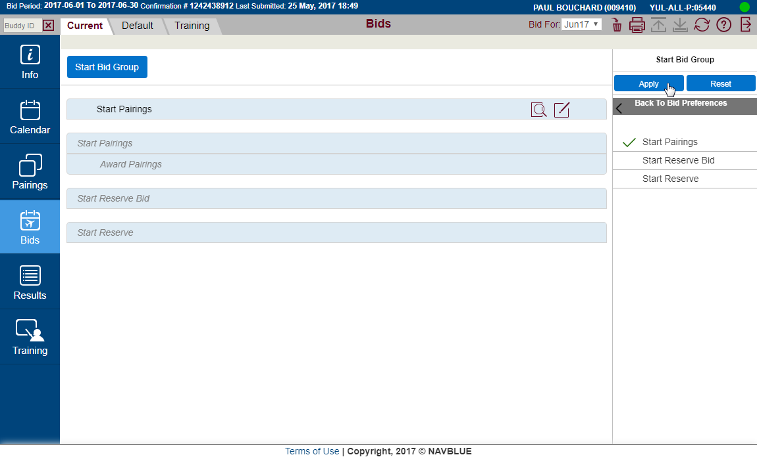
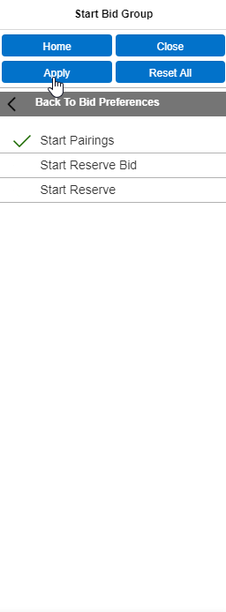
New U.I. - Bidding
Opens Bid Preference Editor

Slide 69
New U.I. - Bidding
Start Pairings is checked

Slide 70
New U.I. - Bidding
Select Apply

Slide 71
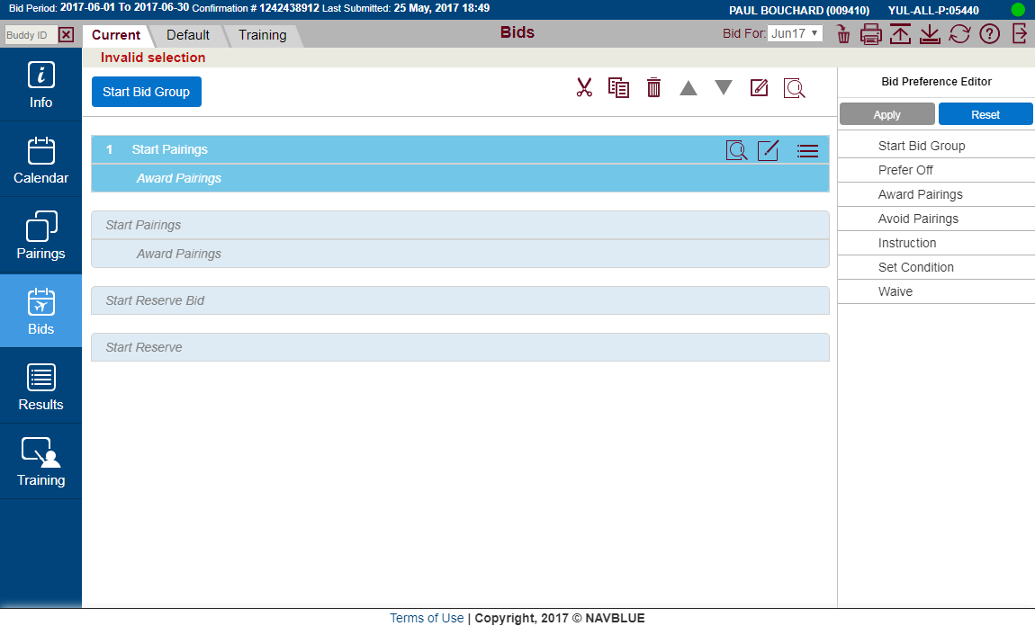
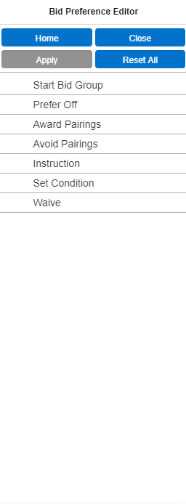
New U.I. - Bidding
Bid group added to bid

Slide 72
New U.I. - Bidding
Bid Preference Editor is active

Slide 73
New U.I. - Bidding
Same bid line categories as before

Slide 74
New U.I. - Bidding
All bid lines will be created in this window

Slide 75
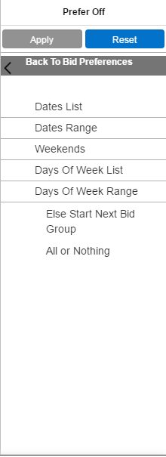
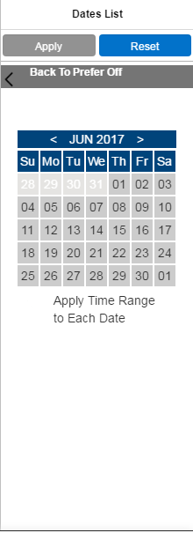
New U.I. - Bidding
Each pane of the Bid Preference Editor
opens over the last as bid lines are created
All bid lines will be created in this window

Slide 76
New U.I. - Bidding
Move back and forth between these panes by using Back To…

Slide 77
New U.I. - Bidding
Add a Prefer Off bid line – select Prefer Off

Slide 78
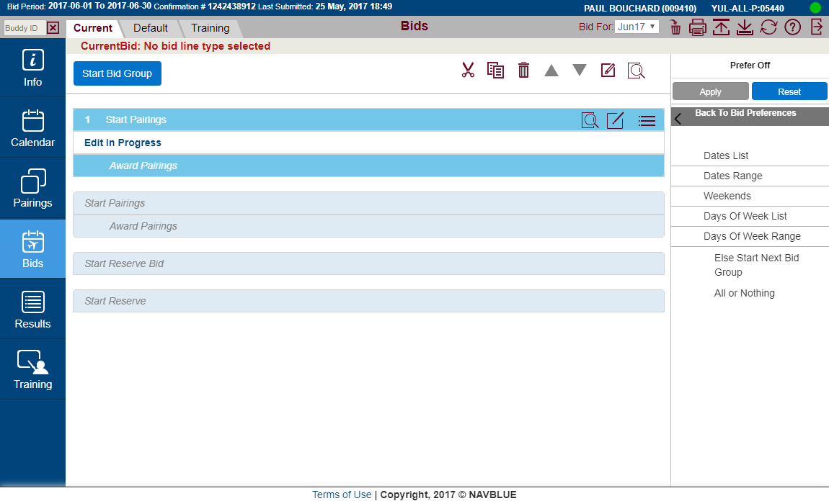
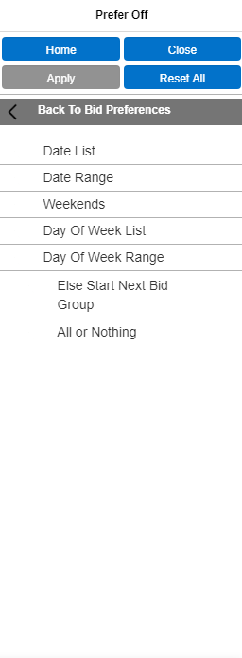
New U.I. - Bidding
[1]
[2]
Prefer Off selected [1] – Prefer Off bid line options [2] displayed

Slide 79
New U.I. - Bidding
[3]
Navigate using the navigation tool [3]

Slide 80
New U.I. - Bidding
[4]
Bid Preference Editor Options [4]:
Home: Go to the main options (home), selections remain
Close: Close Bid Preference Editor
Apply: Add bid line (only available when a complete bid line is possible)
Reset All: Clear all selections and go to main options

Slide 81
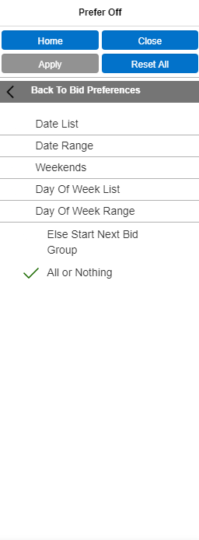
New U.I. - Bidding
ESSNBG + All or Nothing options may be added to the bid line
Click on option to select. Green checkmark = selected

Slide 82
New U.I. - Bidding
We will add a date with a time range and
Else Start Next Bid Group to our prefer off bid line

Slide 83
New U.I. - Bidding
Select Dates List

Slide 84
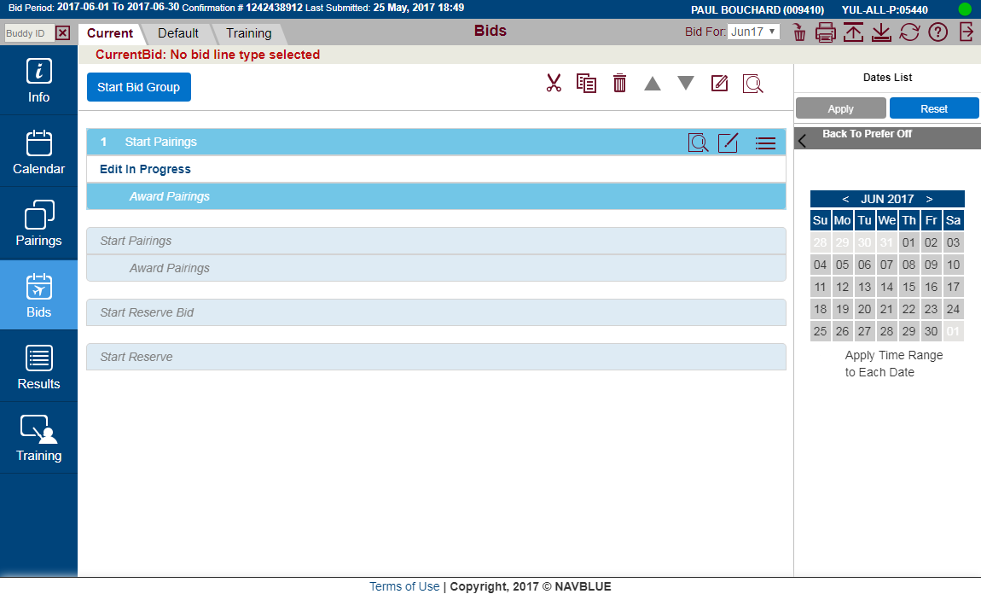
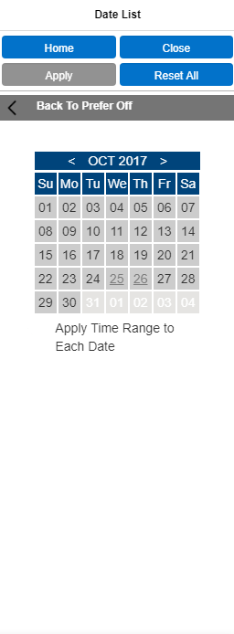
New U.I. - Bidding
Calendar is displayed along with Apply Time Range option
Greyed-underlines dates = pre-assigned activities

Slide 85
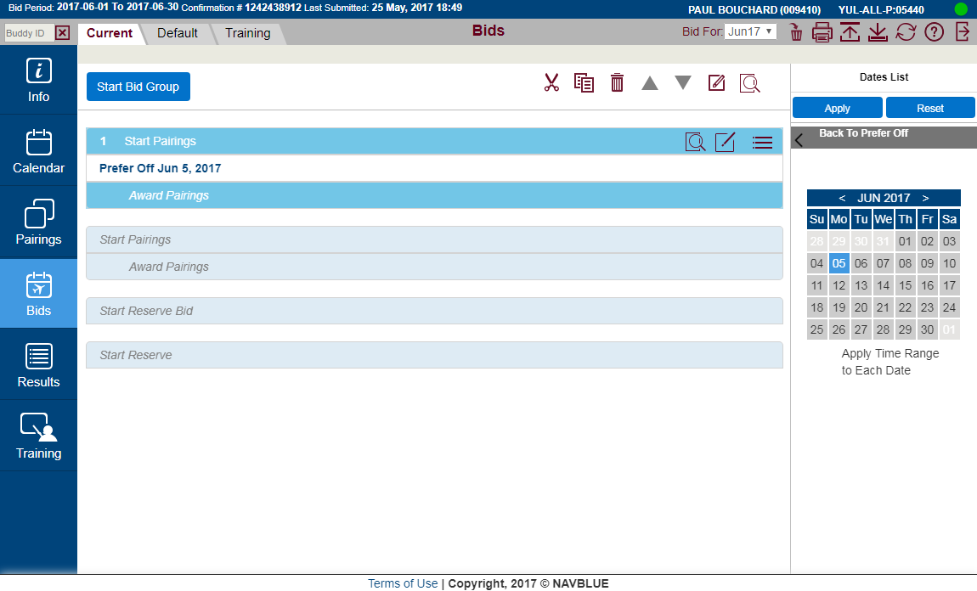
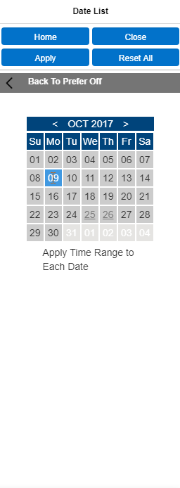
New U.I. - Bidding
Prefer Off October 9, 2017
Click on date to select it

Slide 86
New U.I. - Bidding
[5]
Prefer Off October 9, 2017
Your progress is tracked in the bid line preview [5]

Slide 87
New U.I. - Bidding
Prefer Off October 9, 2017
We will add a Time Range

Slide 88

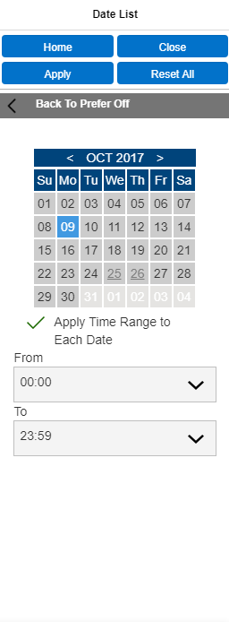
New U.I. - Bidding
Prefer Off October 9, 2017 With Time Between 00:00 And 23:59
Designate From and To times

Slide 89
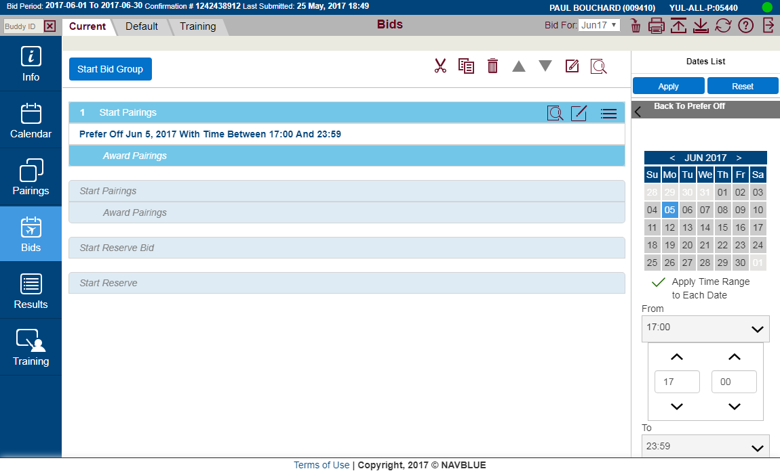
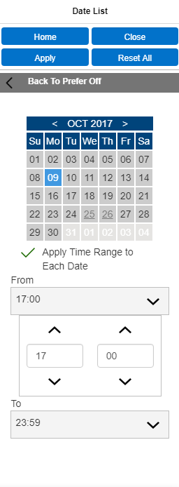
New U.I. - Bidding
Prefer Off October 9, 2017 With Time Between 17:00 And 23:59
Your progress is tracked in the bid line preview

Slide 90
New U.I. - Bidding
Prefer Off October 9, 2017 With Time Between 17:00 And 23:59
We want to add Else Start Next Bid Group to this bid line

Slide 91
New U.I. - Bidding
Prefer Off October 9, 2017 With Time Between 17:00 And 23:59
Click on Back To Prefer Off

Slide 92
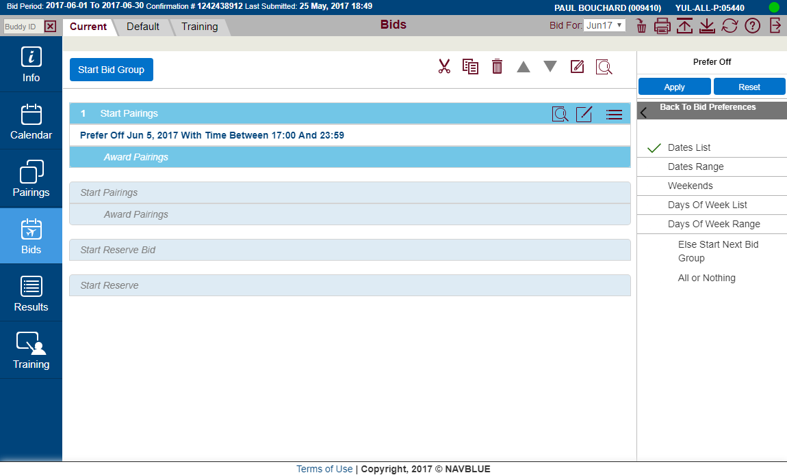
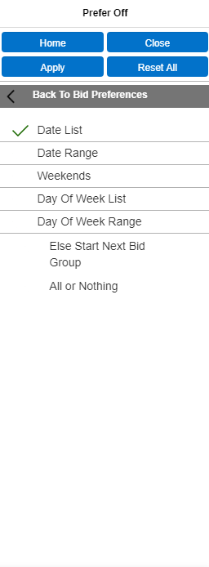
New U.I. - Bidding
Prefer Off October 9, 2017 With Time Between 17:00 And 23:59
Note that we see a green check mark to indicate where there is information stored as we build our bid line

Slide 93
New U.I. - Bidding
Prefer Off October 9, 2017 With Time Between 17:00 And 23:59
Click on Else Start Next Bid Group

Slide 94


New U.I. - Bidding
Prefer Off October 9, 2017 With Time Between 17:00 And 23:59 Else Start Next Bid Group
My bid line is complete

Slide 95
New U.I. - Bidding
Prefer Off October 9, 2017 With Time Between 17:00 And 23:59 Else Start Next Bid Group
Select Apply to add the bid line to my bid

Slide 96

New U.I. - Bidding
Prefer Off October 9, 2017 With Time Between 17:00 And 23:59 Else Start Next Bid Group
Prefer Off October 9, 2017 With Time Between 17:00 And 23:59 Else Start Next Bid Group
My Prefer Off bid line has been added

Slide 97
New U.I. - Bidding
Prefer Off October 9, 2017 With Time Between 17:00 And 23:59 Else Start Next Bid Group
Prefer Off October 9, 2017 With Time Between 17:00 And 23:59 Else Start Next Bid Group
The bid line data is still in memory in case
you want to add a similar bid line

Slide 98
New U.I. - Bidding
Prefer Off October 9, 2017 With Time Between 17:00 And 23:59 Else Start Next Bid Group
Prefer Off October 9, 2017 With Time Between 17:00 And 23:59 Else Start Next Bid Group
If you want a new type of bid line or want to clear the data
select Reset All

Slide 99

New U.I. - Bidding
Prefer Off October 9, 2017 With Time Between 17:00 And 23:59 Else Start Next Bid Group
Edit In Progress
Selecting Reset All clears any data in the Bid Preference Editor
and brings you back to the main preferences

Slide 100
New U.I. - Bidding
Prefer Off October 9, 2017 With Time Between 17:00 And 23:59 Else Start Next Bid Group
Edit In Progress
Let’s add an Award Pairings bid line:
Award Pairings If Departing On Monday If Layover LHR If And If Layover Duration > 036:00

Slide 101
New U.I. - Bidding
Prefer Off October 9, 2017 With Time Between 17:00 And 23:59 Else Start Next Bid Group
Edit In Progress
Select Award Pairings

Slide 102


New U.I. - Bidding
Prefer Off October 9, 2017 With Time Between 17:00 And 23:59 Else Start Next Bid Group
Edit In Progress
Select Depart On

Slide 103


New U.I. - Bidding
Prefer Off October 9, 2017 With Time Between 17:00 And 23:59 Else Start Next Bid Group
Edit In Progress
Select Days Of Week List

Slide 104


New U.I. - Bidding
Prefer Off October 9, 2017 With Time Between 17:00 And 23:59 Else Start Next Bid Group
Edit In Progress
Select Monday

Slide 105


New U.I. - Bidding
Prefer Off October 9, 2017 With Time Between 17:00 And 23:59 Else Start Next Bid Group
Award Pairings If Departing On Monday
Mondays are selected

Slide 106
New U.I. - Bidding
Prefer Off October 9, 2017 With Time Between 17:00 And 23:59 Else Start Next Bid Group
Award Pairings If Departing On Monday
We see our progress so far in the bid line preview

Slide 107
New U.I. - Bidding
Prefer Off October 9, 2017 With Time Between 17:00 And 23:59 Else Start Next Bid Group
Award Pairings If Departing On Monday
Not done yet… Select Back To Depart On

Slide 108


New U.I. - Bidding
Prefer Off October 9, 2017 With Time Between 17:00 And 23:59 Else Start Next Bid Group
Award Pairings If Departing On Monday
Select Back To Award Pairings

Slide 109
New U.I. - Bidding
Prefer Off October 9, 2017 With Time Between 17:00 And 23:59 Else Start Next Bid Group
Award Pairings If Departing On Monday
Note that we see a green check mark where there is information stored as we build our bid line

Slide 110


New U.I. - Bidding
Prefer Off October 9, 2017 With Time Between 17:00 And 23:59 Else Start Next Bid Group
Award Pairings If Departing On Monday
Select Layover

Slide 111


New U.I. - Bidding
Prefer Off October 9, 2017 With Time Between 17:00 And 23:59 Else Start Next Bid Group
Edit In Progress
Select Stations

Slide 112


New U.I. - Bidding
Prefer Off October 9, 2017 With Time Between 17:00 And 23:59 Else Start Next Bid Group
Edit In Progress
Select None Selected to display the stations

Slide 113


New U.I. - Bidding
Prefer Off October 9, 2017 With Time Between 17:00 And 23:59 Else Start Next Bid Group
Edit In Progress
Scroll through the list OR start typing in the 3-letter station code

Slide 114


New U.I. - Bidding
Prefer Off October 9, 2017 With Time Between 17:00 And 23:59 Else Start Next Bid Group
Edit In Progress
We want LHR and have typed “L” in the search field
Any stations with “L” are displayed

Slide 115


New U.I. - Bidding
Prefer Off October 9, 2017 With Time Between 17:00 And 23:59 Else Start Next Bid Group
Prefer Off October 9, 2017 With Time Between 17:00 And 23:59 Else Start Next Bid Group
Award Pairings If Departing On Monday If Layover LHR
Select LHR

Slide 116
New U.I. - Bidding
Prefer Off October 9, 2017 With Time Between 17:00 And 23:59 Else Start Next Bid Group
Award Pairings If Departing On Monday If Layover LHR
We want to define the layover duration
Select Back to Layover

Slide 117


New U.I. - Bidding
Prefer Off October 9, 2017 With Time Between 17:00 And 23:59 Else Start Next Bid Group
Award Pairings If Departing On Monday If Layover LHR
Select Of Duration

Slide 118


New U.I. - Bidding
Prefer Off October 9, 2017 With Time Between 17:00 And 23:59 Else Start Next Bid Group
Prefer Off October 9, 2017 With Time Between 17:00 And 23:59 Else Start Next Bid Group
Award Pairings If Departing On Monday If Layover LHR And If Layover Duration = 000:00
Select Greater Than

Slide 119


New U.I. - Bidding
Prefer Off October 9, 2017 With Time Between 17:00 And 23:59 Else Start Next Bid Group
Award Pairings If Departing On Monday If Layover LHR And If Layover Duration > 000:00
Select the layover Duration

Slide 120


New U.I. - Bidding
Prefer Off October 9, 2017 With Time Between 17:00 And 23:59 Else Start Next Bid Group
Award Pairings If Departing On Monday If Layover LHR And If Layover Duration > 036:00
We want greater than 36 hours

Slide 121
New U.I. - Bidding
Prefer Off October 9, 2017 With Time Between 17:00 And 23:59 Else Start Next Bid Group
Award Pairings If Departing On Monday If Layover LHR And If Layover Duration > 036:00
Double check the bid line preview

Slide 122
New U.I. - Bidding
Prefer Off October 9, 2017 With Time Between 17:00 And 23:59 Else Start Next Bid Group
Award Pairings If Departing On Monday If Layover LHR And If Layover Duration > 036:00
All is good – select Apply

Slide 123

New U.I. - Bidding
Prefer Off October 9, 2017 With Time Between 17:00 And 23:59 Else Start Next Bid Group
Award Pairings If Departing On Monday If Layover LHR And If Layover Duration > 036:00
Award Pairings If Departing On Monday If Layover LHR And If Layover Duration > 036:00
Our Award bid line has been added

Slide 124
New U.I. - Bidding
Prefer Off October 9, 2017 With Time Between 17:00 And 23:59 Else Start Next Bid Group
Award Pairings If Departing On Monday If Layover LHR And If Layover Duration > 036:00
Award Pairings If Departing On Monday If Layover LHR And If Layover Duration > 036:00
Delete All – Print – Submit – Save – Synchronize – Help – Exit

Slide 125
New U.I. - Bidding
Prefer Off October 9, 2017 With Time Between 17:00 And 23:59 Else Start Next Bid Group
Award Pairings If Departing On Monday If Layover LHR And If Layover Duration > 036:00
Award Pairings If Departing On Monday If Layover LHR And If Layover Duration > 036:00
Cut – Copy – Paste – Delete Selected – Move UP – Move DOWN
Edit – Analyze – Insert ABOVE – Insert BELOW

Slide 126
New U.I. - Bidding
Prefer Off October 9, 2017 With Time Between 17:00 And 23:59 Else Start Next Bid Group
Award Pairings If Departing On Monday If Layover LHR And If Layover Duration > 036:00
Award Pairings If Departing On Monday If Layover LHR And If Layover Duration > 036:00
Analyze – Close Bid Preference Editor

Slide 127

New U.I. - Bidding
Prefer Off October 9, 2017 With Time Between 17:00 And 23:59 Else Start Next Bid Group
Award Pairings If Departing On Monday If Layover LHR And If Layover Duration > 036:00
Award Pairings If Departing On Monday If Layover LHR And If Layover Duration > 036:00
Alternate access to functions

Slide 128

New U.I. - Bidding
Prefer Off October 9, 2017 With Time Between 17:00 And 23:59 Else Start Next Bid Group
Award Pairings If Departing On Monday If Layover LHR And If Layover Duration > 036:00
Open Bid Preference Editor

Slide 129

New U.I. - Bidding
Prefer Off October 9, 2017 With Time Between 17:00 And 23:59 Else Start Next Bid Group
Award Pairings If Departing On Monday If Layover LHR And If Layover Duration > 036:00
Select multiple bid lines by clicking on the bid line number

Slide 130
New U.I.
New Features

Slide 131

New U.I. – New Features
Set Condition – No Same Day Pairings
2
Set Condition No Same Day Pairings
When added to a bid group instructs PBS to not award two pairings that touch the same CALENDAR DAY
Like all Set Condition bid lines:
  Will be placed at the top of your bid
  No pairings are awarded with a Set Condition bid line
  May not be forgotten
  May be denied

Slide 132

New U.I. – New Features
Set Condition – Minimum Days Off In A Row
3
Set Condition Minimum Days Off In A Row 3
Minimum Days Off
When added to a bid group instructs PBS to keep a minimum of a set number of days off in a row
May include absences like vacation, LOAs, etc.
Like all Set Condition bid lines:
  Will be placed at the top of your bid
  No pairings are awarded with a Set Condition bid line
  May not be forgotten
  May be denied

Slide 133


New U.I. – New Features
Award – Followed By
5
Award Pairings If Departing On Jul 3, 2017 Followed By Pairings (Allow Intervening) If Departing On Jul 5, 2017
When added to a bid line instructs PBS to award a pairing followed by another
No other activities may occur between the two pairings unless Allow Intervening Activities is selected
Intervening Activities include training and/or other
Any pairings awarded in the second part of the Followed By bid line MUST be chronologically after the pairings awarded in the first part of the bid line

Slide 134

New U.I. – New Features
Award – Pairing Number Departing On (Ordered)
6
Award Pairings If Pairing Number (Ordered) C5012 Departing On Jul 2, 2017, C5018 Departing On Jul 6, 2017
Pairing Number Departing On
Allows you to add more than one pairing number departing on a date to a bid line AND have PBS see the order in which they appear when YES is selected under the Ordered option
Does not prevent Substitution (moving of pairings awarded to honour higher preferences)

Slide 135

New U.I. – New Features
Award – Pairing Number Departing On (Ordered)
6
Award Pairings If Pairing Number (Ordered) C5012 Departing On Jul 2, 2017, C5018 Departing On Jul 6, 2017
Ordered option is NO by default, change to YES to have order followed by PBS

Slide 136




New U.I. – New Features
Award – Pairing Number Departing On (Ordered)

Slide 137

New U.I. – New Features
Award/Avoid – Carry Out
7
Avoid Pairings If Carry Out > 0 Days
Carry Out
Carry Out = Overlap pairing
Specify the number of days a pairing may overlap
No overlaps: Avoid Pairings If Carry Out > 0 Days

Slide 138

New U.I. – New Features
Award/Avoid – Pairing Carry-Out Credit
8
Award Pairings Carry-Out Credit > 006:00
Pairing Carry-Out Credit
Carry-Out Credit = Credit of an overlap pairing carried into the next block month
Specify the number of hours credit an overlap pairing would have in the next block month

Slide 139

New U.I. – New Features
Award/Avoid – Pairing In-Period Credit
9
Award Pairings If In-Period Credit > 005:00
Pairing In-Period Credit
In-Period Credit = Credit in the block month of an overlap pairing
Specify the number of hours credit an overlap pairing would have in the block month

Slide 140

New U.I. – New Features
Award/Avoid – Position GJ
10
Award Pairings If Layover LHR If Position GJ
Position
Renaming the “GP” position to GJ on all wide body aircraft
When more than one position is added, PBS will see the order in which they appear on the bid line
When no positions are on the bid line, PBS will consider the order to be:
  FA
  GJ
GY will be introduced in a future update of PBS
If you have a Default Bid with GP it MUST be changed to GJ for PBS to recognize it

Slide 141

New U.I. – New Features
Award/Avoid – Any + Every
11
Award Pairings If Any Layover Of Duration > 016:00
Any = Any of the selected conditions must
exist in the pairing
Every = Every one of the selected conditions
must exist in the pairing
Available with:
  Aircraft Type
  Duty Duration
  Duty Legs
  Enroute Check-In Time
  Enroute Check-Out Time
  Layover
  Sit Length
  Employee Number
  Aircraft Type replaces Any Aircraft / All Aircraft

Slide 142

New U.I. – New Features
Award/Avoid – Total Legs In Pairing
12
Award Pairings If Total Legs In Pairing < 6 If Total Legs In First Duty < 3 If Total Legs In Last Duty < 3
Legs = operating flight legs
Total Legs = number of operating legs in the entire pairing
Ability to also define legs in first duty period and last duty period
Deadhead legs not counted UNLESS the Counting Deadhead Legs is selected

Slide 143

New U.I. – New Features
Award/Avoid – Pairing from Pairing Tab
Ability to add pairings to your bid as:
  Award If Pairing Number #####
  Avoid If Pairing Number #####
Bid line added to active bid sheet (Current or Default)
Select pairings from list and click Award or Avoid
  You MUST have created a Start Pairings bid group for the bid line to be added

Slide 144
New U.I. – New Features
Changes – Off-Line Mode
Ability to use PBS Off-Line
  Create bids
  Search pairings
  Analyze bid lines/bid groups
  Save bids
  NOTE:
  Bid information must first be synchronized
  Bids must be submitted (when on-line) to be used for award process

Slide 145
New U.I. – New Features
Changes – Removals / Syntax
Removal of “Charters” bid line
Retirement of the Desktop PBS Bidder
  Features now included in the New U.I.
Removal of “FAR” numbers on calendar
Syntax Changes (Pairings):
  Forget > Forget Line
  Redo From > Redo From Line
  Consecutive Days Off > Consecutive Days Off In A Row
  Maximum Credit > Maximum Credit Window
  Minimum Credit > Minimum Credit Window
  Syntax Changes (Reserve):
  Consecutive Days Off > Consecutive Days Off In A Row

Slide 146
New U.I. – New Features
Changes – Logic: Prefer Off Day(s) of Week
Prefer Off (Day of Week) to be processed like Prefer Off Weekends
  Prefer Off Friday now to be processed as “Give me as many Fridays as you can”
  No specific order of preference from one Friday to another
  May use the Minimum option
  May use the Time Range option
  May not be forgotten
  NOTE: Prefer Off (Specific calendar date): No change in logic
  Prefer Off Jul 12, 2017, Jul 15, 2017 is still seen as July 12th having a priority over July 15th

Slide 147
New U.I.
Support

Slide 148
New U.I. – Support
Current Interface to be active for a four (4) month transition period
  During this period both systems may be used interchangeably
  You may save a bid on one interface and then continue with the other
  Additional bulletins will be sent out as we get closer
  Additional support for local PBS Committees during transition period

Slide 149
PBS – New U.I.
Thank you!

Slide 150
PBS – New U.I.

