Slide 1
A ‘How To’ Guide For Being On Reserve
Knowing your Rights, the Company’s expectations and the Collective Agreement

Slide 2
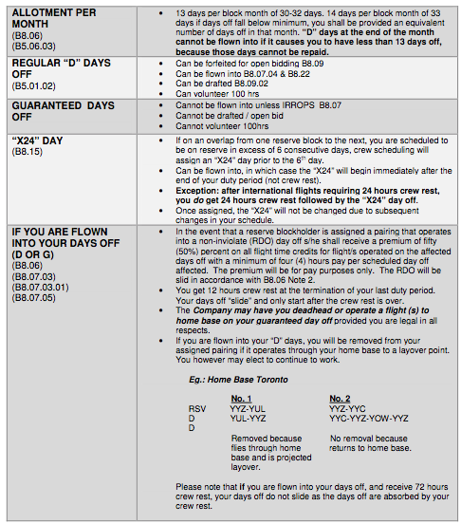
Days Off
Explained
‘D’ days
&
‘G’ Days

Slide 3
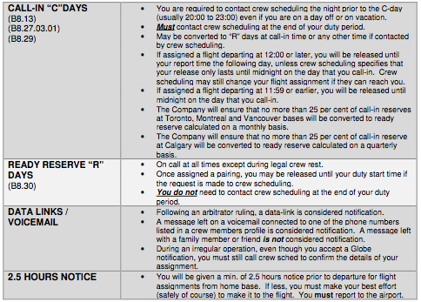
Reserve Types & Notification

Slide 4
Call-in “C” Days
- Required to contact crew scheduling (CS) the night prior to the “C” day (usually 20:00 to 23:00) even if you are on a day off, on crew rest or on vacation. Contact must be made via phone (not through globe).
- At call-in time, the CS will either assign a flight sequence, change the reserve status to ‘ready reserve’ or release the reserve until the next call-in time
- On a “C” day you MUST call CS at the end of your duty period
- The “C” day may be converted to a “R” day at call in time or any time CS contacts you
- If assigned a flight 12:00 or later, you will be released until report time the following day, unless CS specifies that your release lasts until midnight. CS may change your assignment if they can reach you.
- If assigned a flight departing 11:59 or earlier, you will be released until mid-night on the day that you called in.
The Company will ensure that no more than 25% (twenty-five percent) of call-in reserves at YYZ, YUL and YVR bases will be converted to ready reserve calculated on a monthly basis (and that no more than 25% of call in reserves at YYC will be converted to ready reserve calculated on a quarterly basis). [B8.29]
[Article B8.27]

Slide 5
Call-in “C” Days Release
There are times where the Company wants to ensure they have as much flexibility and legal crews available when the weather gets bad, IRROPS situations and crew availability may be compromised, especially in the winter months. Please note that when given a “reserve release” on Call-In days, these days are at no cost, and you are paid for that day as if you were on call.
We tend to get calls asking for clarification on this as members will self notify through Globe. The Union strongly advises you to follow your Collective Agreement and Call-In to scheduling and have the scheduler show you as notified. Call-In days are meant to have you Call-In for an assignment the night prior, self notification is not a contractual way to be notified of an assignment.

Slide 6
Ready Reserve
“R” Days
An employee that is on ready reserve will be on call at all times during his/her scheduled reserve duty days except during legal crew rest periods.
- An employee who has not been awarded an assignment, will on request, be granted a six (6) hour release for personal reasons if it is operationally practicable to do so
- Once an employee on ready reserve has been assigned a pairing, that employee shall not be required to contact CS upon completion of that assigned pairing
[Article B8.30]

Slide 7
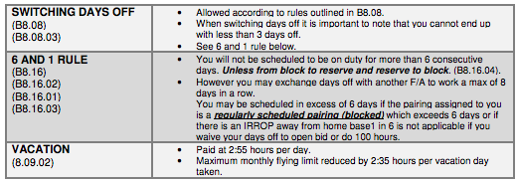
Days Off & Vacation
Days Off – Forfeit
A reserve may bid open flying on or into his/her non
inviolate days off provided that such days off are scheduled to
terminate prior to the last seven (7) days in the block month and that
the conditions outlined in B.7 Open Flying, are met
Note: The restriction on bidding open flying in the last seven (7) days of the month may be waived by the Crew Resource Center
Days off may be forfeited through the open-flying bid if the open flight awarded overlaps into days off providing all other conditions of this Article are met. Days off may be forfeited only by cabin personnel and only for the purpose of bidding open time. An employee will not be permitted to forfeit days off for a draft and any day off lost due to draft will be repaid by another day off in that month.
Days off lost as a result of such open flying bid will not be repaid, however, in no case will the total days off in that month be reduced to less than ten (10).
An open flying bid will include confirmation in writing that the employee agrees to reduce his/her days off for the purpose of that open time award.

Slide 8
Days Off – Forfeit
A reserve may bid open flying on or into his/her non inviolate days off provided that such days off are scheduled to terminate prior to the last seven (7) days in the block month and that the conditions outlined in B.7 Open Flying, are met
Note: The restriction on bidding open flying in the last seven (7) days of the month may be waived by the Crew Resource Center
Days off may be forfeited through the open-flying bid if the open flight awarded overlaps into days off providing all other conditions of this Article are met. Days off may be forfeited only by cabin personnel and only for the purpose of bidding open time. An employee will not be permitted to forfeit days off for a draft and any day off lost due to draft will be repaid by another day off in that month.
Days off lost as a result of such open flying bid will not be repaid, however, in no case will the total days off in that month be reduced to less than ten (10).
An open flying bid will include confirmation in writing that the employee agrees to reduce his/her days off for the purpose of that open time award.
[ Article B8.09 ]

Slide 9
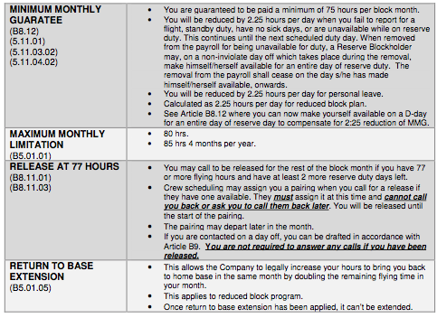
Monthly Limitations and Guarantees, Release at 77 hours
& Return To Base Extension

Slide 10
Monthly Limitation
Release at 77 hours
[ Article B8.11 ]
An employee who, at the termination of his/her last duty period, has accumulated seventy-seven (77) or more hours of flight time credits, and has at least two (2) scheduled reserve duty days remaining will, at his/her OPTION, be released from further reserve duty in that month provided s/he cannot be assigned at that time. If s/he is assigned a pairing s/he will be released on those reserve duty days not involved in the assignment. The option to decline such pre-assignment as per B8.28 does not apply.
Any change to such assignment will be made at report time and the employee will then be required to operate any other assignment for which s/he is legal. The employee will be required to advise the Crew Resource Centre of his/her decision to be released.

Slide 11
Although an employee who is released under the provision of this clause is not required to be available for contact, s/he will be required to operate an assigned pairing if s/he is contacted and legal in all respects for that assignment. S/he may also be drafted in accordance with Article B9 on any day scheduled as a non-inviolate day off in his/her reserve block provided s/he can be contacted and is legal in all respects.
Monthly Limitation
Release at 77 hours - Continued
An employee who, at the termination of his/her last duty period, has accumulated seventy-seven (77) or more hours of flight credits, and has at least two (2) scheduled reserve duty days remaining will, at his/her OPTION, be released from further reserve duty in that month provided s/he cannot be assigned at that time. If s/he is assigned a pairing s/he will be released on those reserve duty days not involved in the assignment. The option to decline such a preassignment as per B8.28 does not apply

Slide 12
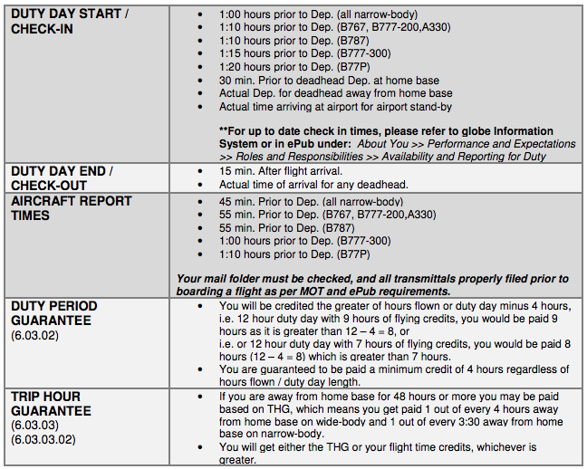
Duty Periods,
Report Times and
Duty Period Guarantee
Appendix_II_Summary_of_Duty_Periods_CA.pdf

Slide 13
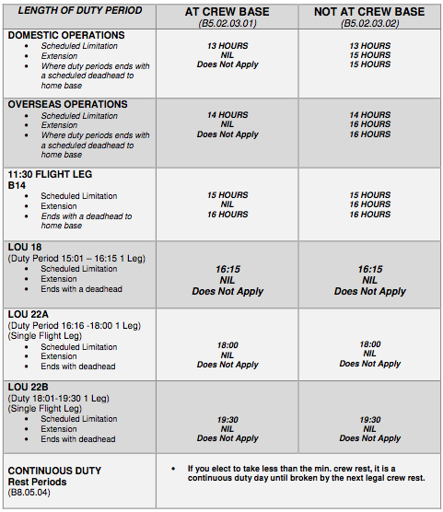
Reserve Duty Day

Slide 14
Reserve Duty Day
Continued

Slide 15
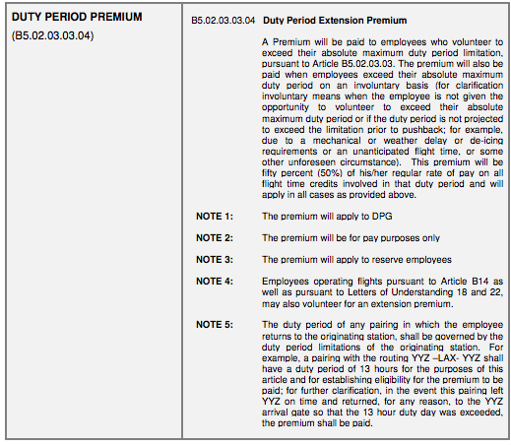
Duty
Period
Extension
Premium

Slide 16
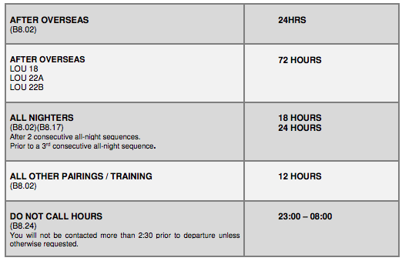
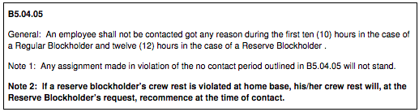
Crew Rest at
Home Base
Non Contact Hours

Slide 17
Legal Crew Rest
-Home Base
Rest Periods – Home Base
A rest period at home base must be of the following minimum duration:
After two (2) consecutive all night sequences: 18 hours
Prior to a third consecutive all night sequence: 24 hours
After an overseas flight (except Bermuda): 24 hours
After all other flights: 12 hours
[ Article B8.02 ]

Slide 18
Rest Periods – Layover Station
A rest period at a layover station must be of the following minimum duration:
Sleeping accommodation at or near the airport: 10 hours
Sleeping accommodation away from the airport: 10 hours
After an Overseas flight to a North American layover station: 12 hours
-After a Canada – London, England flight: 12 hours
Legal Crew Rest
-Layover Station
[ Article B8.03 ]

Slide 19
Scheduled Rest Periods
-Layover Station
Scheduled Rest Periods – Layover Station
The scheduled rest period at a layover station must be of the following minimum duration except in an irregular operation (IRROPS) then they may be reduced to the periods stated in Article B8.03 preceding
Sleeping accommodation at or near the airport: 10 hours
After a scheduled duty period of twelve (12) hours or more: 12 hours
Between any two (2) consecutive scheduled duty periods which total twenty (20) hours or more: 12 hours
[ Article B8.04 ]

Slide 20
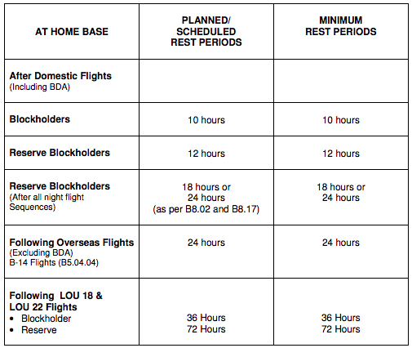
CREW REST
Appendix III - Summary of Legal Rest Periods

Slide 21
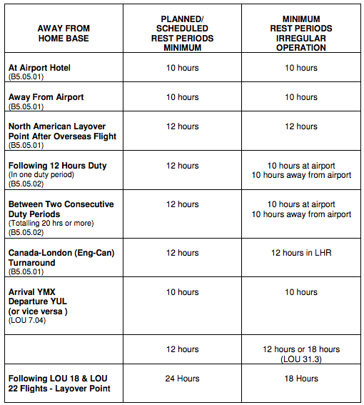
AIR CANADA SHALL NOT DIRECTLY CONTACT CABIN PERSONNEL DURING THEIR
MINIMUM LEGAL REST PERIOD OR PRIOR TO 2 ½ HOURS PRIOR TO DEPARTURE
(B5.05.01)
Note: LHR is an exception; you may be contacted 3 hrs prior to departure.

Slide 22
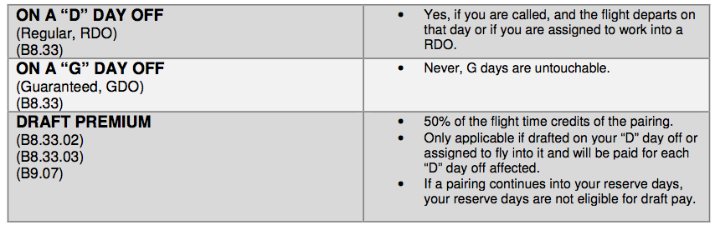
DRAFT

Slide 23
DRAFT TRUMPS OPEN FLIGHT ASSIGNMENT
If an employee is drafted on a non-inviolate day off prior to an awarded open flight and such draft interferes with the awarded open flight then the draft will take precedence and the awarded open flight will be dropped.
INELIGIBILITY FOR DRAFT: Cabin Personnel who will fall below their minimum total guaranteed days off are ineligible for draft where these cannot be repaid in that month.
DRAFT PREMIUM APPLICATION
Draft premium will not apply on any day other than a non-inviolate day off. An employee is not eligible to be drafted on an inviolate day off.

Slide 24
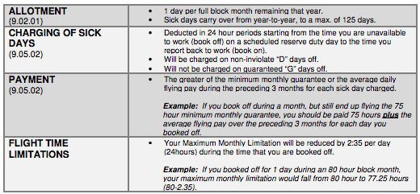
SICK LEAVE

Slide 25
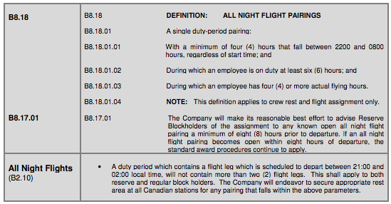
Night Flights

Slide 26
Airport Standby – What’s the limit?
The criteria for airport standby, as per article B8.20.02 in the CA the verbiage is very clear; all reserve members at your base must have been assigned two airport standby periods prior to a third period being assigned to any reserve member.
If you are assigned a third airport standby, speak with the crew scheduler and inquire as to whether or not all reserve members have been assigned two airport standby periods in the month? If not advise them of the above article and clarify that you should not be working a third standby stint until all members have been assigned two.
In the case the crew scheduler is not receptive, accept the assignment and contact your reserve committee or local Union office immediately. Inform them of the situation, that you brought this article to their attention and they still did not remove the third airport standby assignment
If there is no one immediately available *remember to ‘work now and grieve later’

Slide 27
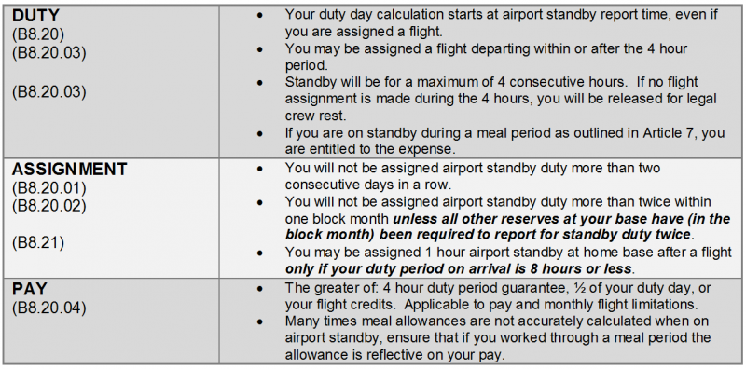
Airport Standby

Slide 28
Airport Standby Continued
As per Article B8.21 AIRPORT STANDBY AFTER FLIGHT:
A Reserve Blockholder may, on arrival at Home Base after a flight, be required to remain on standby at the airport for a maximum of one (1) hour ONLY if his/her duty period on arrival is eight (8) hours or less. S/he may be assigned to a flight departing within or after the one (1) hour period and if no assignment is made, s/he must be released for a legal rest. The duty period, for pay and limitation purposes, will end at release time.
The one (1) hour standby after a flight commences does NOT count towards the maximum of two (2) per month.

Slide 29
Airport Standby Continued
If a Crew Member is assigned a flight by Crew Scheduling and then there is an event of IRROPS (irregular operations) and CS calls it is legal to assign an airport standby though the maximum limitation of two (2) airport standby assignments does not apply

Slide 30
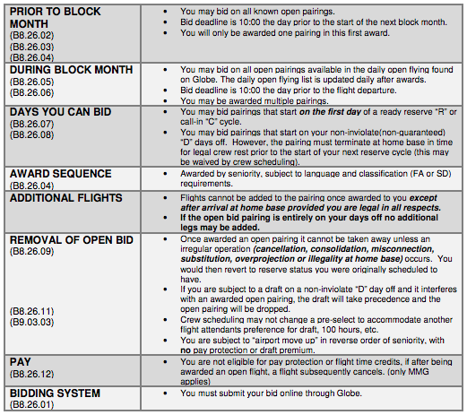
OPEN
FLIGHTS

Slide 31
Understanding
Pre-Select
A Pairing shall not be assigned when the effect of the assignment would be to overproject the employee and cause him to drop a preselected cycle. In establishing the overprojection, Return to Base Extension B5.01.05 will be applied to the preselected cycle.
It is our (the Unions) understanding that the language regarding the Pre-Select should be strictly followed
CHANGE OF ASSIGNMENT: An employee who has been assigned an open flight (B8.26) or who has been pre-assigned to an open flight (B8.28) may have such assignment altered in the event of an irregular operation caused by cancellation, consolidation, substitution, misconnection, overprojection or illegality at Home Base. Such change in assignment will normally be made at report time and the employee will be required to operate any other assignment for which s/he is legal.
NOTE: If an employee has been awarded an open flight on his/her non- inviolate days off (B8.09) s/he will have the option to not accept a move-up or reassignment on his/her days off.

Slide 32
Article B8.26.09 is clear on when the company can remove a reserve:
B8.26.09 An open pairing once awarded to a Reserve Blockholder will not subsequently be changed except in the event of an irregular operation caused by cancellation, consolidation, substitution, misconnection, overprojection or illegality at Home Base. The employee involved will revert to the reserve status s/he was scheduled to hold had s/he not been awarded the pairing.
The union is looking for your assistance in reporting ANY and ALL awarded open flights (pre-selects) that have had deviations, changes or when you have been removed from the pairing as a whole or any flight within the pre-selected pairing.
Please email full details along with the following:
Time your assignment was changed, time you were notified
When and/or where the change occurred (mid pairing/ prior to check in/ on layover/ etc.)
Who notified you of the change
Why did the change happen?
Employee Name, Number and pairing details
We understand the frustration you have had with the constant changes to an established pairing. The emails and calls to the locals are growing to an all time high on pre-selects and we want to address it.

Slide 33
Change of Assignment
An employee who has been assigned an open flight (B8.26) or who has been pre-assigned to an open flight (B8.28) may have such assignment altered in the event of an irregular operation caused by cancellation, consolidation, substitution, misconnection, over-projection or illegality at Home Base. Such change in assignment will normally be made at report time and the employee will be required to operate any other assignment for which s/he is legal.
A pairing shall not be assigned when the effect of the assignment would be to overproject the employee and cause him/her to drop a preselected cycle. In establishing the overprojection, Return to Base Extension B5.01.05 will ne applied to the preselected cycle [B8.22.01.0]
See Article B10 for further clarification on Irregular Operations (IRROPS)
[Article B8.31]

Slide 34
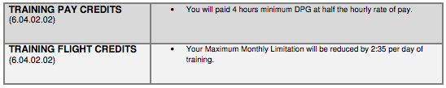

Voluntary Extension
Training Credits
Extension to monthly
100 Hours

Slide 35
Cabs/Taxi’s for mainline reserves – When can I request one?
For members on reserve there are a few scenarios where you are entitled to a cab (taxi) to get to or home from the airport.
Article 7.01.02 and 7.01.03 in the CA are your reference points. You can request a cab:
- If notification is made less than 4 hours prior to flight departure or standby report time
-If required to report to the airport if flight departure or standby start time is between 00:01 and 08:00
-If required to report to airport for flight departure or standby start time within 15 hours of termination of last duty period
-If arrival is after 00:00 and prior to 06:00

Slide 36
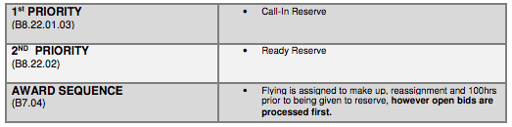
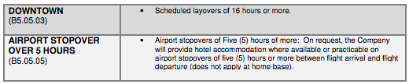
Order of Assignment:
LAYOVER
POLICY:

Slide 37
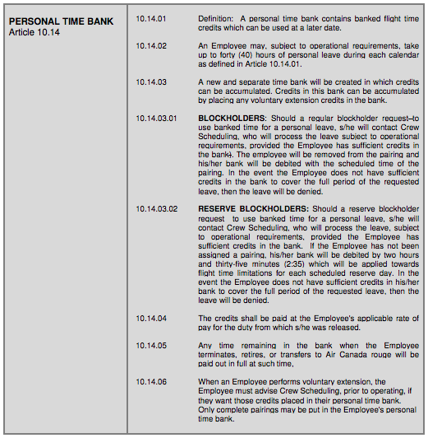
Personal
Time
Bank

Slide 38
SCHEDULED DEADHEAD
Scheduled Deadhead Extension to Home Base:
For the deadhead to be ‘scheduled’ for the purpose of being on reserve, it would mean that crew scheduling placed the deadhead in your schedule prior to the beginning of the duty day.
A duty period may be scheduled for up to fifteen (15) hours for domestic flights or sixteen (16) hours for overseas flights only to complete a deadhead to Home Base provided the flight duty was scheduled within the scheduled limitation of thirteen (13) hours for domestic flights or fourteen (14) hours for overseas flights.
[ Article B5.02.02.02 ]

Slide 39
Crew Care Reporting
To access and provide feedback regarding any and all instances that make your hotel stay or transportation to and from the airport unpleasant, please ensure to report on the Crew Care dashboard.
Ex. dirty linens in room, rude or insulting communications from drivers / hotel staff, loud or noisy stays etc.
Log Into ACAeronet >
  In-Flight Service >
    Crew Scheduling & Planning >
      Crew Care

Slide 40

Local Reserve Contacts:
YVR Local 4094 Contacts
officers@local4094.ca
YVR Reserve Committee:
reserve@local4094.ca
YVR PBS Cpmmittee:
pbs@local4094.ca
YVR Local 4094 Office Telephone Number:
604-295-4259
Component Reserve Contact:
If you have any questions or concerns that are not of immediate urgency, Duty Mangers are available at: duty.manager@aircanada.ca
We ask that you CC: or BCC: the Union for all inquiries
Please do not hesitate to contact either your Local Union or the Component Reserve Committee for any clarification or with further questions.

